Slide 1
The Power of Collaboration – Part 2
Paul J. Shives, VP and Director of Safety Services

Slide 2


Agenda for Part Two
Land Use Liability
Liability for Child Abuse and Domestic Violence
Environmental Risk Management
Cyber Risk Management
Emergency Management and Crisis Communication
Community Safety Issues
NJ Gov’t Employees Ethics Act
Open Public Meetings Act
Open Public Records Act

Slide 3

Land Use Liability
Cases usually involve request for injunctive relief, not monetary damages. However, there is one large exception we will discuss.
Land Use boards enjoy broad immunities. However, the immunities do not apply when boards violate an applicant’s civil rights.
Based on 5th Amendment protections, which provides that private property shall not be taken without “just compensation.”
Inverse Condemnation (1922 US Sup Ct decision), where zoning laws significantly diminish the value of a private property. (Ruled a “taking” without compensation.)
Cell towers, group homes, adult books stores

Slide 4

Land Use Liability
What does NIMBY stand for, and how does that relate to Land Use liability cases?

Slide 5

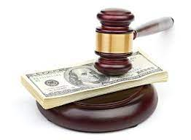
What is the definition of “Fee Shifting?”

Slide 6

Land Use Liability - RLUIPA
Religious Land Use and Institutionalized Persons Act

Slide 7
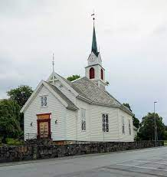
Land Use Liability - RLUIPA
Passed unanimously in both houses of Congress and signed into law in 2000.
Addresses religious discrimination and government infringement of religious liberty in two areas: local land use laws such as zoning and the religious exercise of persons confined to institutions.
Needed because faith groups whose members constitute only 9% of the population made up 50% of the reported cases involving zoning disputes.
“Zoning codes frequently exclude churches in places where they permit theaters, meetings halls, and other places where large groups of people assemble for secular purposes. . . . Churches have been denied the right to meet in rented storefronts, in abandoned schools, in converted funeral homes, theaters and skating rinks—in all sorts of buildings that were permitted when they generated traffic for secular purposes.”

Slide 8

Land Use Liability - RLUIPA
RLUIPA codified the constitutional protections for religious freedom and against religious discrimination provided under the Free Exercise Clause, the Free Speech Clause, and the Equal Protection Clause, and provide mechanisms for enforcement of these rights.
Fee shifting applies to these cases.
The land use section contains five separate provisions, which together provide comprehensive protection for individuals and religious institutions from zoning and landmarking laws that discriminate based on religion or unjustifiably infringe on religious freedom.

Slide 9

RLUIPA Cases – Al Falah Center v. Bridgewater (2013)
A Muslim congregation proposed to build a conforming mosque and educational center on the site of a former hotel. Within two months, the town changed the Zoning Ordinance to require a church to seek a conditional use variance if located in a residential zone. The town argued that traffic would be an issue, but the expert for the Muslim congregation disagreed and provided documentation.
Federal Court ruled against the town and was swayed by how quickly the town had acted to change the ordinance. The town paid $2.5 million to purchase another property for the mosque, and the Town’s insurer paid the mosque’s $5 million in legal fees.

Slide 10

RLUIPA Cases – Tenafly Eruv Assoc. v. Tenafly (2002)
A group of Orthodox Jewish residents attempted to create an enclosed “Eruv” zone that would allow them to push or carry objects outside their home on the Sabbath. The utility company agreed to allow the Eruv’s (running plastic string high and out of site on utility poles.) However, the town pushed back by enforcing a 1954 Town ordinance that prohibited placing signs on utility poles.
Court ruled against the town due to “selective enforcement” of the ordinance, and cited numerous examples of similar sign violations in the past that were overlooked.

Slide 11

RLUIPA Cases – Albanian Assoc. Fund v. Township of Wayne,
New Jersey (2007)
For years, the Township of Wayne, New Jersey blocked the Albanian Associated Fund (AAF), a Muslim congregation, from building a mosque. The congregation’s efforts were opposed by a so-called “Property Protection Group” in the community, who labeled the mosque a “public nuisance.” Instead of protecting the First Amendment rights of the congregation, Wayne Township suddenly decided that it needed to seize the future home of the mosque for “open space.”
Federal Court ruled that the use of eminent domain power to bypass zoning regulations could violate RLUIPA. The parties ultimately agreed to settle the case.

Slide 12
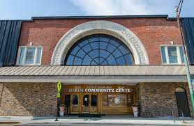
RLUIPA Cases – Muslim Community Assoc. v. Ann Arbor (2013)
A religious institution applied for zoning variances to build a school in a residential zone. A Board member lived in a nearby development. She coached her neighbors on what questions they should ask at the hearing and did not recuse herself from the deliberations.
Court ruled that the board member who helped residents draft their objections was not entitled to personal immunity because she acted in bad faith.

Slide 13

Land Use Case – Schad v. Mt. Ephraim (1981)
Town adopted a zoning ordinance that prohibited adult bookstores and theaters in its commercial zone.
Plaintiff challenged the ordinance, and the U.S. Supreme Court overturned the zoning ordinance because it allowed a broad range of other uses in its commercial zone, including bookstores and theaters. Therefore, the town was singling out a particular type of speech for regulation which is not lawful.
Note: In 1986 the same court upheld a zoning ordinance in Renton v. Playtime Theaters that prohibited adult theaters within 1,000 feet of a residential zone. The court ruled that establishing a “buffer” zone is acceptable in this case.

Slide 14
Inherently Beneficial Uses
40:55D-4 a definition of “inherently beneficial use” as follows: “a use which is universally considered of value to the community because it fundamentally serves the public good and promotes the general welfare (2000).
Some Examples:
  Hospitals
  Schools
  Child Care Centers
  Group Home
  Wind Energy Facility
  Solar Energy Facility

Slide 15
Group Homes in New Jersey
What laws apply to the siting of a community residence?
The Federal Fair Housing Act (42 U.S.C. 3601 et seq.):
  Prohibits local zoning rules to discriminate in housing opportunities for the disabled;
  Makes it unlawful to deny a dwelling to any buyer or renter because of a handicap.
  The Municipal Land Use Law (N.J.S.A. 40:55 D-66.1 and 66.2):
    Requires all residential districts in the State to permit new community residences.
    Specifically protects community residences that are licensed by the State
    Prohibits municipal authorities from excluding group homes from their communities (S.210); and requires handicapped individuals to be placed in community residences whenever possible (N.J.S.A.30:6-D-13 and N.J.S.A. 30:11B-1)
    In addition, State Statute (N.J.S.A. 30:11-B-5) ensures that homes for the handicapped are geographically “available throughout the State without unnecessary concentration.” These living arrangements are established in N.J. S. A. 30:11B-1 et. seq.
    Stringent standards for opening, licensing and operating a community residence are delineated in N.J.A.C. 10:44A.

Slide 16

Liability for Child Abuse

Slide 17

Statistics on Child Abuse
Reports involving 80,000 NJ children are filed annually
50,000 of these children receive prevention and post-response services
37% of all children are reported to child protective services by their 18th birthday

Slide 18

Liability for Child Abuse
Under recent legislation, you can be held personally responsible if you fail to act. How?

Slide 19

Exposure To Personal Liability
Possible Issues:
  Failure to carry out a full and complete background check
  Failure to train your employees properly
  Failure to properly supervise your employees
  Failure to document hiring practices, training, and education
  Failure to take appropriate action on possible abuse claims

Slide 20
Liability for Child Abuse
The new NJ statute allows childhood victims of sexual molestation to file suit until they turn 55, or until seven years from the time that they became aware of their injury, whichever comes later. Further, for those previously barred from seeking recovery, the law establishes a two-year window to file suit.
Previously, the time limit was two years past your 18th birthday to file.
There is a “retroactive” provision in the new law as well, allowing refiling of old claims that were barred by the old statute of limitations.

Slide 21
Extended Statute of Limitations for Victims to File
Previously:
  Victims of child sexual abuse and molestation had until two years past their 18th birthday to file a notice of claim or lawsuit.
Under the new law passed in 2019:
  Victims now have until they turn 55 years of age, or seven (7) years from the time the victim became aware of the abuse, whichever is LATER, and;
  Victims previously barred by the SOL, have a 2 year window to file or re-file claims
  So:
    18 YOA plus 2 years = 20 YOA versus:
    55 YOA OR 7 years from the time the victim is aware of the abuse
      SOL is Extended by at least 35 Years!!!

Slide 22

Definition of an Abused Child
“Anyone under the age of 18 who is caused harm by a parent, guardian or other person having custody or control of that minor.” (N.J.S.A. 9:6-8.4)

Slide 23




Role of Government
State Government
  Family and Criminal Court Systems
  Juvenile Court System and Detention Centers
  Department of Families and Children
Local Government
  Schools
  Municipal and County Programs
    Recreational Programs
    Jr. Police, Firefighter, and EMS programs
    Library Programs
    Housing Authority residents and programs

Slide 24
Four Types of Abuse
Neglect
Physical Abuse
Emotional Abuse
Sexual Abuse

Slide 25

Indicators of Abuse
The New Jersey Department of Children and Families has issued guidelines to assist in recognizing the indicators of child abuse/neglect.
It is recommended that all public sector employees who come in contact with children familiarize themselves with the indicators.

Slide 26

Unexplained or unusual fractures, burns, bruises or welts in any stage of healing on a child, particularly in a pattern or grouping that might reflect the shape of the object used.
The timing of these injuries can be significant, especially if they appear after a weekend or vacation.

Slide 27
Wariness of adult contact,
Fear of parents or going home,
Apprehension when other children cry,
Extreme behaviors like aggression or withdrawal

Slide 28
Poor peer relationships,
Begging or stealing food,
The inability to stay awake in classes,
Being unwilling to change for gym or participate in P.E.,

Slide 29
Preferring to remain withdrawn and immersed in fantasy, and
Acting in ways much too adult or too infantile for their age.
Sexual behaviors or strong sexual language that is too adult for their age.
Many children feel at fault after the abuse and begin to suffer guilt and depression, even resorting to self-harm.
Also look for cuts and scratches or other self-inflicted injuries.

Slide 30

Long Term Effects of Child Abuse
A lack of trust and difficulty with healthy relationships is common
A core feeling of worthlessness and low self-esteem
Long-term trouble with regulating emotions that can lead to destructive behaviors.

Slide 31

Peer-to-Peer Sexual Abuse
Peer-to-Peer is by far the most common, where one or more child or adolescent sexually abuses or inappropriately touches another.
Legally, the abuser must be at least 4 years older to trigger the statute.

Slide 32

Peer-to-Peer Sexual Abuse
The American Psychological Association reports that peer-to-peer abuse is driven by power and dominance, the same factors that drive bullying.
Bullying is often a precursor to sexual abuse, especially when there is a lack of supervision

Slide 33
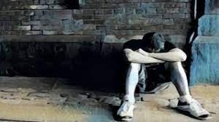
Adult-to-Child Sexual Abuse
Adult-to-Child sexual abuse is thought out and planned in advance, demanding access and privacy and control.
90% of juvenile sexual abuse victims know their abuser.
By age eighteen, 1 in 4 girls and 1 in 6 boys have experienced sexual abuse.
88% of adult-to-child molestations are attributed to individuals with pedophilia, which is defined as the sexual preference in children.
    However, it is important not to confuse the attraction of pedophilia with actual child molestation, as many pedophiles never act on their attractions.

Slide 34

Adult-to-Child Sexual Abuse
7 out of 8 sexual molesters are male, but molesters match the general population in ethnicity, religion, education, and marital status. So, there is no stereotype, especially since abusers go to great lengths to blend in.
Only 10% of abusers molest children that they don’t know, and 68% look no further than their own families for victims.
    40% of abusers first begin molesting children before they themselves reach the age of 15. (i.e., Peer to Peer). Teenagers generally begin with abusing younger siblings. Acts of abuse by strangers are very rare.

Slide 35


Cyclic patterns are common with 47% of child sexual abusers admitting that they themselves were sexually abused as children.

Slide 36

Adult-to-Child Sexual Abuse
While most abuse occurs within the family, molesters also gain access to children through employment or volunteer work. This allows them both time alone with potential victims and the ability to build trust.
Child abusers are often known and respected in their communities for dedication to children.
While every child is in danger, abusers are attracted to:
  Passive, lonely or troubled children, especially those who live with step-parents or single parents
  The most vulnerable age: between 7 and 13 years old.
  Children from low socioeconomic backgrounds or rural areas are more likely to be victimized.

Slide 37
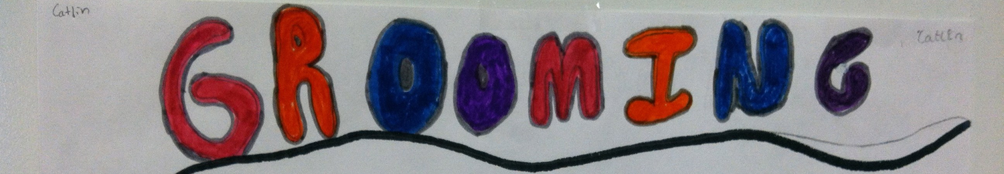
Molesters have behavioral patterns that can be identified as “grooming” their victims.
Sexual abuse is rarely violent.
The molester’s goal is to build a manipulative relationship, often started by showing favoritism to build trust.
Molesters often refer to their intended victims by pet names and use gifts to foster exclusivity and build a relationship while starting the practice of keeping secrets.
The molester might begin to spend time with the victim outside of the regular program, contacting parents to become involved in a child’s life in some capacity, like babysitting.

Slide 38


Adult-to-Child Sexual Abuse
Inevitably, the favoritism is not enough to keep the victim silent, and the abuser resorts to threats—threats that play off of a child’s guilt over the sexual contact.
Research shows that children often delay reporting sexual abuse. They should not be disbelieved just because they waited a long time to seek help.

Slide 39


Reporting Child Abuse in New Jersey
As a governmental official, employee or volunteer, you are legally required to report suspected child abuse. This requirement includes all governmental officials, employees AND volunteers.
Unlike other states, New Jersey specifically provides that: “Any person having reasonable cause to believe that a child is being subjected to abuse shall report this immediately.”

Slide 40

Reporting Child Abuse in New Jersey
Any person who, in good faith, reports suspected abuse or testifies in a child abuse hearing is immune to any criminal or civil liability that may result.
  You can choose anonymous reporting.
When dealing with a child who might be abused, the most important thing to remember is to show calm reassurance and unconditional support.
  Avoid interrogation and leading questions; let the child explain in their own words. Anything else could confuse and fluster a child, making it hard to continue. DO NOT ATTEMPT TO INVESTIGATE THE ALLEGATION!

Slide 41



Reporting Child Abuse in New Jersey
If there is the possibility of violence against yourself or the child, get the appropriate professionals or agencies involved as soon as possible.
“DUAL” Reporting

Slide 42

“In Loco Parentis”
The legal doctrine that grants responsibility to an individual or organization to act in a child’s best interest.
  This makes individuals or organizations liable if the child is harmed while under their supervision.
  Think of all of the possible interactions children may have while participating in your programs, attending programs in buildings you own or control, or living in your facilities.
  REMEMBER, the SOL has been extended by at least 35 YEARS…..
Examples: Schools, daycare centers, recreational programs and custodial correction facilities.

Slide 43
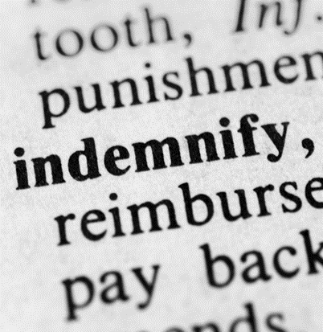
Defense and Indemnification
Your governmental entity probably has arrangements for your defense and indemnification. (Check to see if your entity has an Indemnification Policy for employees.)
You should talk with your municipal, board or authority attorney to understand exactly how these defense and indemnification procedures work.

Slide 44


Best Practices to Protect Yourself and Your Local Government
Background Checks – ALL employees and volunteers
  MEL has a list of five vendors
  Include both employment and personal references
  Megan’s Law check in NJ and other states if applicant lived there
  Maintain documentation for 65 years
Provisional Hiring is NOT recommended
If there is an arrest or conviction, employees should be required to report it to your HR department within 72 hours.

Slide 45


Best Practices to Protect Yourself and Your Local Government
Training
  Virtual Webinar
  Video on MEL and NJCEL Websites
Training for Volunteer Coaches
  Rutgers Safety Clinic Course OR approved alternative
  Video for Coaches who took the RU course more than 5 years ago
US Center for Safesport
  https://uscenterforsafesport.org/response-and-resolution/disciplinary-database/

Slide 46

Best Practices to Protect Yourself and Your Local Government
A written protocol for notifying the parents or guardian of a minor in case of an emergency, whether medical or behavioral, natural disaster, or any other disruption.
  Annual Medical treatment authorization forms.
A policy that forbids the release of children to anyone other than the parent, guardian, or other authorized adult.
  Policies that prohibit staff or volunteers from transporting children in their own vehicles without written authorization.

Slide 47

Best Practices to Protect Yourself and Your Local Government
Policies forbidding staff and volunteers from meeting with a child alone and in private.
Guidelines that restrict images taken of children as part of an activity from being shared on social media without expressed consent from parents or guardians.
Anti-hazing policies that cover cyber bullying.
Procedures for the monitoring of bathrooms.

Slide 48

Resources
Model Policy for the Protection and Safe Treatment of Minors
Training Video (20 minutes) for volunteers and employees
  https://njmel.org/mel-safety-institute/model-policies/protecting-children/

Slide 49

Domestic Violence Impacting Public Employees in NJ

Slide 50

Domestic Violence Statistics
There are over 70,000 reported cases of domestic violence annually in New Jersey
26% of females and 29% of males in New Jersey will be the victims of domestic violence in their lifetimes.
In the US, an average of 20 people experience intimate partner physical violence every minute. This equates to more than 10 million abuse victims annually.
HOWEVER, most cases of domestic violence are never reported to the police
Children are either directly hurt or are “collateral” damage in about 1/3 of all domestic violence cases.

Slide 51

NJ Domestic Violence Policy Act for Public Employers
Passed in January 2018
Law directed the NJCSC to develop a uniform domestic violence policy and requires all public employers to adopt a written policy concerning reporting and handling of domestic violence
On October 15, 2019, NJCSC issued its uniform domestic violence policy
Posted on MEL Website with “fill in the blanks”
Employers may modify the uniform policy; however, they must provide the same or higher level of protection and service to their employees. NJSCS must approve any policies that are not the same as their policy.

Slide 52

NJ Domestic Violence Policy Act for Public Employers
All employees must be covered under the policy (full time, part time, seasonal, interns, volunteer, and temporary employees.)
Employer must designate a Human Resource Officer (HRO), and a backup
Employees must be made aware of the Policy, and how to report an incident

Slide 53

NJ Domestic Violence Policy Act for Public Employers
HRO
  Designed to assist employees or members of their family who have been victims of domestic violence.
  HRO also helps employees work through the NJ Security & Financial Empowerment Act (NJ SAFE)
  Training is mandatory and available on the NJ Civil Service Commission Website for the HRO.

Slide 54
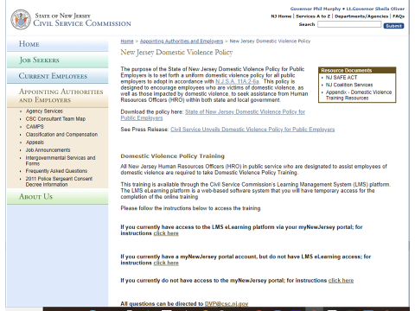
HRO Training

Slide 55

NJ SAFE Act
The New Jersey Security and Financial Empowerment Act (NJ SAFE Act)
  applies to employers with 25 or more employees and grants an employee 20 days of leave in a 12-month period if the employee, or the employee’s family member, including a child (under 19 or of any age incapable of self-care), parent, spouse, domestic partner, or civil union partner, has been the victim of domestic violence or a sexually violent offense.
  employers may no longer require employees to use accrued paid leave; and
  employees are now eligible for Family Leave Insurance benefits.

Slide 56

Prevention of Domestic Violence Act for Law Enforcement officers
A law enforcement officer must make an arrest when the officer finds “probable cause” that domestic violence has occurred. This holds even if the victim refuses to make a complaint.
The Act is invoked in situations where the victim exhibits signs of injury caused by domestic violence, when a warrant is in effect, or when there is probable cause to believe that a weapon has been involved in an act of domestic violence.
If a child is present, the officer must report the situation to the Department of Children and Families for further investigation.
Domestic violence is not just about physical assault. Abusers often use psychological tactics to gain control over their partners, such as making threats to prevent a victim from leaving, or contacting friends or the police.

Slide 57

Protecting Children – Cases - J.H. v. Mercer County (2007)
A 24-year-old female detention center employee started a sexual relationship with a 17-year-old inmate at a county detention center. He was a very troubled young man who entered treatment with another Agency after he turned 18 and was released from the county facility. A lawsuit was filed to recover medical bills. The county argued that while the molester can be held liable, the county itself has immunity from vicarious liability under Title 59.
Court ruled that both the county and the employee can be held liable. Under the current law, the County Board of Commissioners could also be held to be personally liable for failure to implement appropriate safeguards.

Slide 58

Protecting Children – Cases – L.E. v. Plainfield Bd. of Ed. (2018)
A girl was pushed into the boy’s bathroom in a high school, where she was sexually assaulted. The lawyers for the Board of Education argued that while, under Title 59, the perpetrator of the crime can be sued, the public entity itself has an immunity for failure to provide adequate police protection.
The Court ruled in favor of the plaintiff, stating that the Board of Education has a duty to implement reasonable measures to prevent student-on-student assault, including enforcement of a system of hall passes, maintaining supervision of students in class and preventing free entry into school buildings.

Slide 59

Protecting Children – Cases – G.A.H. v. K.G.G. (2019)
A 44-year-old, privately-employed, EMT had a sexual relationship with a 15-year-old girl. He told a co-worker about the relationship, but not her age, and showed the co-worker pornographic photos of her on his cell phone. After five months, the teen informed her mother, who then notified the police. The molester pleaded guilty and was jailed. Four years later, the victim sued, alleging that the molester’s co-worker should have reported the situation to his supervisors and the employer was vicariously liable for negligent hiring, training, and supervision.
NJ Supreme Court ruled that the facts did not create a reasonable basis for the co-worker to believe that his colleague was in a sexual relationship with a minor. The Court pointed out that it is often difficult to know someone’s age based on appearance alone.
If this was a PUBLIC ENTITY, the decision would likely have been different.

Slide 60



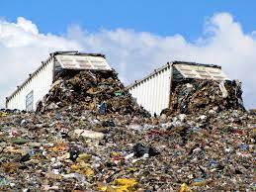
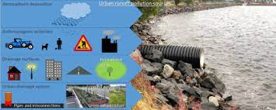
Environmental Risk Management

Slide 61
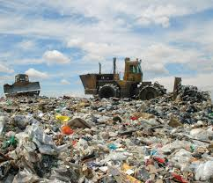
Environmental Risk Management
Environmental Liability was not a large concern to local governments in NJ until 1983, when Ayers v. Jackson Township was decided.
  Involved contamination of well-water by toxic pollutants leaching into the Cohansey Aquifer from the Jackson Township landfill. Jury found that the township had created a “nuisance” and a “dangerous condition,” by virtue of the operation of the landfill. The jury also found the township’s conduct to be “palpably unreasonable.”
  Jury awarded $2 million for emotional distress and $5.4 million for deterioration of the residents’ quality of life. Also, $8.2 million was placed in a fund to cover the future cost of annual medical monitoring.

Slide 62

Environmental Risk Management
  This case established the principle that the cost of pollution claims must be shared by all of the General Liability insurers that covered Jackson Township during the many years that toxic waste was deposited in the landfill.
  Resulted in the private insurance market discontinuing coverage to municipal entities.
  State of NJ created the NJ Spill Compensation Claims Program in 1987
    Funded by a tax on the petroleum and chemical industries
    Double-edged for NJ local governments
  NJ MEL decided to create a “specialized” pool of environmental claims
  E-JIF formed in 1993

Slide 63

Environmental Joint Insurance Fund (E-JIF)
Current membership includes 13 Joint Insurance Funds, encompassing 313 municipalities, 72 authorities and seven other entities.
Unmatched success
Most extensive coverage available to local governments in the US, including five coverage areas:
  Third Party Liability
  On-Site Clean Up Costs
  Public Officials Pollution Liability
  De Minimis Abandoned Waste Sites
  Storage Tank Systems

Slide 64

Environmental Joint Insurance Fund (E-JIF)
  Third Party Liability
    Covers local government activities that may cause pollution or damage to the property of others
  On-Site Clean Up Costs
    Covers remediation of pollution caused by others on public property
  Public Officials Pollution Liability
    Fills the gap for insurance no longer provided by the commercial market
  De Minimis Abandoned Waste Sites
    Covers damage to others
  Storage Tank Systems
    USTs and ASTs
    E-JIF provides a “grant” program of $10,000

Slide 65

Environmental Joint Insurance Fund (E-JIF)
Risk Control
  E-JIF contracts with engineering companies to assist members
Environmental Audit Services
Petroleum Storage Tanks
UST’s and ASTs
Continuing Education Training
24-Hour Emergency Response Consulting
Foreclosed Property Screening

Slide 66
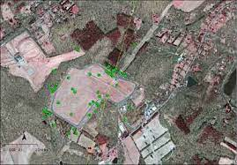
Environmental Liability Cases- RE: Combe Fill South Landfill (1998)
Combe Fill South Landfill was in operation from the 1940’s until it was closed via EPA Order in 1981. Accepted municipal waste and sewage sludge, septic tank waste, chemicals and waste oil. EPA sued approximately 250 parties to recover clean-up costs estimated to be more than $150 million in 1998. The suit included 21 municipalities insured by the E-JIF.
Lawsuit was settled against the 21 E-JIF members for $3.8 million. Much of the money came from prior insurers. E-JIF used “archiving” to identify and document the insurers that previously insured the 21 members. Large savings in legal costs by the E-JIF managing this case.

Slide 67
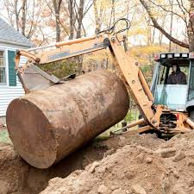
Environmental Liability Cases- RE: Toms River Township Lagoon Drive (2003)
DPW crew accidentally ruptured a heating oil line while installing a storm water pipe in an easement between two homes, extensively contaminating one of the houses. The clean-up was complicated by the fact that the property backed up to a waterway, and the line ran under the slab foundation of the house.
In order to avoid very costly litigation, the E-JIF decided that the best way to resolve the case was to purchase the property from the elderly homeowner and demolish the structure. The E-JIF sold the property after the clean-up and recovered over $300K of the $800K total cost.
Reflects the flexibility and creativity of the E-JIF.

Slide 68
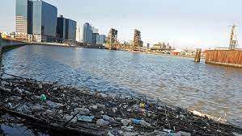
Environmental Liability Cases- RE: NJDEP v. Occidental Chemical e. al. (2005)
Chemical plants along the Passaic River discharged toxic materials that poisoned the six-mile stretch in Newark, Harrison, East Newark, and Kearny. Of special concern was dioxin, used to manufacture Agent Orange during the Vietnam War. Because of tidal movement, the high concentrations of dioxin also contaminated other areas of the river and the NJ/NY Harbor. The direct defendants counter-sued numerous municipalities, 32 of which were E-JIF members, alleging municipal storm water runoff and discharge from sanitary processing plants contributed to the contamination.
E-JIF was able to settle the case for just over $2 million. E-JIF paid $50K for each town per the policy and the defense costs. Each town paid $45K; however, the local JIFs picked up those costs so no member had any out-of-pocket costs for the suit.

Slide 69
Break Time
We will now take a 10-minute break. Please be back in ten minutes. Thank you!

Slide 70
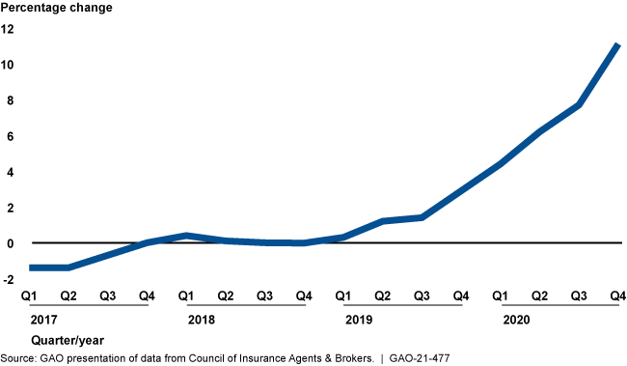
Technology Risk Management - Cyber Claims

Slide 71

The Statistics
In 2019, there were 23,399 reported cyber attack incidents impacting local government
Malware-loaded phishing attempts has reached a rate of 1 per every 302 emails received in the public sector
  Ransomware
  PIP (Personally Identifiable Information) sold on the “dark web”
  Stealing Bank Credentials or Valuable Financial Information
Results in disruption of service, possibly emergency response delays
Reputation of the local government and officials is compromised

Slide 72

The Statistics
Top Four Causes of Cyber Losses in 2021 and Overall and Per Claim Costs
  Email Compromise
    $2.8 million in Total Claims and $200,000 per Claim
  Hackers
    $1.9 million in Total Claims and $83,000 per Claim
  Staff Error
    $300,000 in Total Claims and $19,000 per Claim
  Ransomware
    $11.3 million in Total Claims and $157,000 per Claim

Slide 73

The Latest Trends
19% of breaches due to compromised credentials and 16% due to third-party vulnerabilities
48% of data breaches were caused by human error or system glitch (57% for Public Sector)

Slide 74
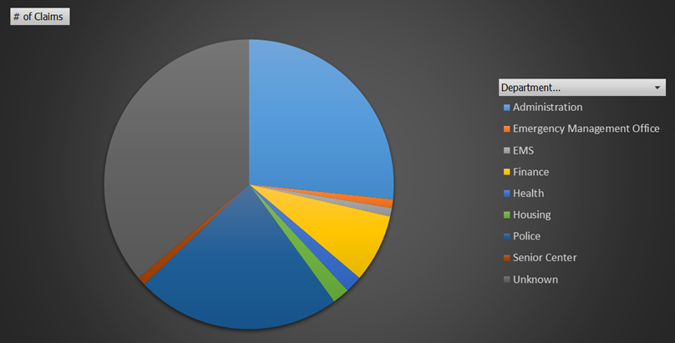
The Latest Trends

Slide 75
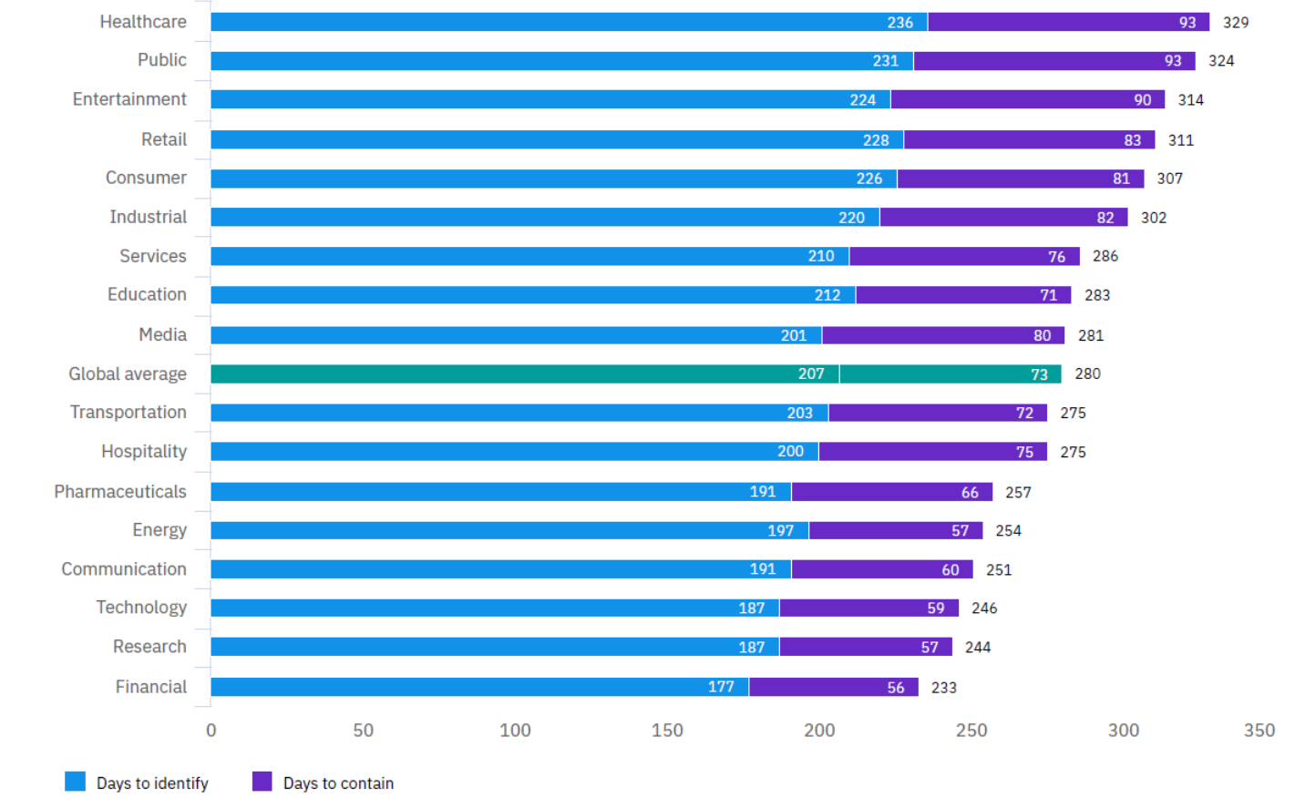
Time to Identify and Contain a Breach

Slide 76
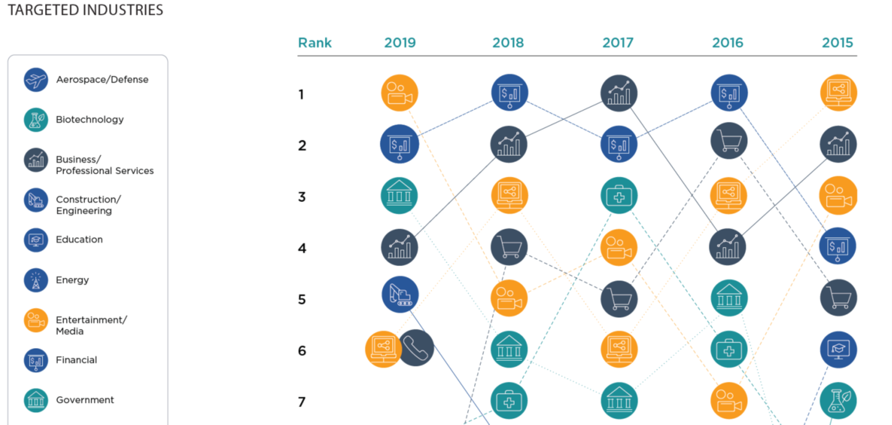
Targeted Industries

Slide 77

Basic Cyber Security
A trusted employee or consultant to advise on technology management
Test backup procedures that restore operating systems and data in the event your technology and access is compromised

Slide 78

Cyber Security and Claims
Based on the large number of claims, and the average size of the claims incurred by the Joint Insurance Funds that are members of the NJ Municipal Excess Liability Fund (NJ MEL), the MEL Fund Commissioners are considering the formation of a separate joint insurance fund to handle only Cyber claims.
This action would require approval by the NJ DOBI and the NJ DCA.
The target date would be sometime in early 2023.

Slide 79

Technology Management
If feasible, a Full-Time, In-House Information Technologies (IT) Director
  Prepare an annual IT Plan that includes a cyber risk assessment analysis for the top administration and governing body to review
  Establish and periodically test a Cyber Security Incident Response Plan
Strongly consider retaining a Cyber Auditor for an annual independent review of your system, policies and practices
Join the NJ Chapter of Government Management Information Sciences (GMIS)
Also enroll in:
    NJ Cyber Communications and Information Cell (NJCCIC)
    Multi-State Information and Analysis Center (MS-ISAC) funded by Dept. of Homeland Security

Slide 80

Technical Competency - Basics
Back-Up Plan - “Reasonable Recovery”
Security - No unauthorized access
Software - Defensive Software, Anti-malware, virus, spam and firewalls
Cyber Hygiene:
Training
Password Policy
Internet and Email Use Policies
Personal Information Security
Testing

Slide 81
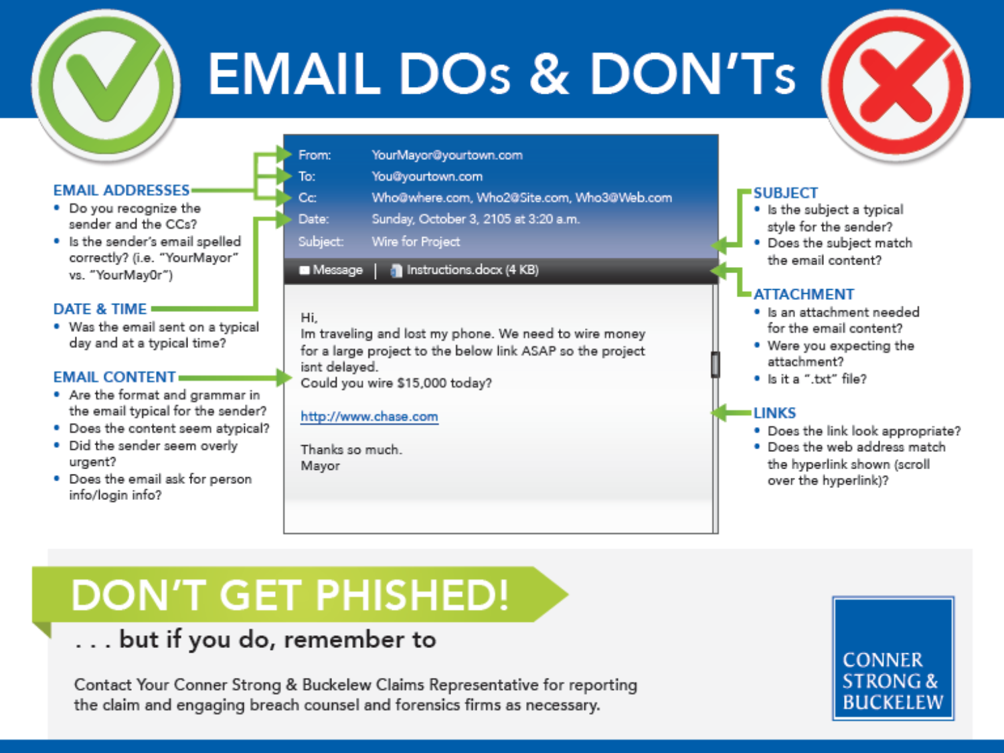

Slide 82

Case Studies – Cyber
An employee received an e-mail from a popular company during the December holiday season and clicked on the link to check package delivery status. The link downloaded malware to the network that encrypted the police system. The attacker demanded ransom while rummaging through the police network.
All costs, subject to the deductible, were covered. A cyber and forensics expert were engaged to remediate the breach and replace the equipment.

Slide 83
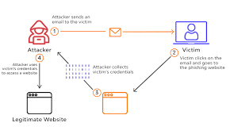
Case Studies - Cyber
A cyber attacker was able to obtain a municipality’s banking information from an unwitting employee.
The attacker used this information to transfer $500,000 to a fake account. Only a portion of the money was recovered. The insurance policy covered the remaining lost funds and other associated expenses.

Slide 84
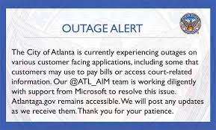
Case Studies – Cyber – City of Atlanta, GA
In March 2018, hackers targeted Atlanta’s computer networks. Demanding $51,000 in bitcoins, the cyberattack held the city hostage for nearly a week. Some city services reverted to pen and paper to continue operations.
The city refused to pay: It didn’t want to reward and encourage more ransomware attacks, and there was no guarantee that systems would be restored even if paid. Ultimately, the financial hit to the city was far higher than the ransom. One city report uncovered by the Atlanta Journal-Constitution estimated that the costs associated with the attack could reach as high as $17 million.
“We’re not here to necessarily stop the attacks,” Atlanta Chief Information Officer Gary Brantley said on a panel Monday at CityLab D.C. “We’re here to prepare for the inevitable.”

Slide 85
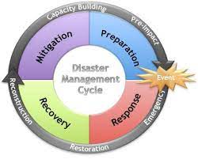
Local Emergency Preparedness and Response

Slide 86


Emergency Preparedness
FEMA was created in 1979 to coordinate the federal response to emergencies and disasters
NJ Office of Emergency Management, under the NJ State Police, coordinates disasters in four major areas, including interaction with local governments
  Severe Weather
  Hazardous Materials Training and Response
  Radiological Preparedness
  Local Emergency Operation Plans Development Process

Slide 87

Emergency Preparedness –
Emergency Management Coordinator
State law requires appointment of a resident as the Emergency Management Coordinator (EMC) for a term of three (3) years
  Depending on the size of the municipality, some EMCs are full-time while others are part-time
  Appointment of an experienced person is a must
  Cannot have any conflicting duties
  Cannot be subordinate to other public safety professionals, should report directly to Mayor or his/her designee to be effective.
  Must have the authority to declare a “State of Emergency” under the NJ Emergency Management Act, and codified in the local Emergency Operation Plan
  Will be the person coordinating municipal resources during an emergency
  Must, at least complete a home study course and workshop as training , plus annual NJ OEM requirement of 24 hours of training.

Slide 88

Emergency Preparedness –
Emergency Planning Committee (LEPC)
Required under Federal and State Law
Should include representatives of all agencies involved in emergency response and recovery
The group is chaired by the EMC. Recommended representatives:
  Mayor and/or B.A.
  At least one other elected official
  Police Chief
  Fire Chief
  Health Officer
  IT Professional
  DPW Superintendent
  Municipal Engineer
  School Representative
  Construction Official
  CFO
  Media Representative or PIO
  Optional – Risk Manager, or local Safety Director

Slide 89

Emergency Preparedness –
Emergency Operations Plan (EOP)
EOP Must contain the following “Annexes:”
  Basic Plan – including an assessment of vulnerabilities
  Alert, Warning and Communications
  Damage Assessment
  Emergency Medical Services
  Emergency Operations Center (EOC)
  Emergency Public Information
  Evacuation Plans
  Fire Services
  Hazardous Materials
  Public Health
  Public Works
  Radiological Protection
  Resource Management
  Shelter, Reception and Care
  Social Services
  Terrorism

Slide 90
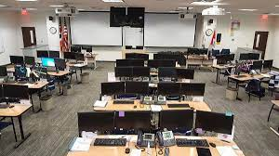
Emergency Preparedness –
Emergency Operations Plan (EOP)
Most EOPs now include an annex for high-risk facilities, cyber crime, and global pandemics
Must be updated every two years, but an annual update is recommended
Must be submitted for review and certification to the NJOEM every four years
Assignments for each type of incident is critical
Incident Management and how well you respond and coordinate is key
  Incident Command System (ICS)
EOC – where the key players gather to coordinate the response

Slide 91
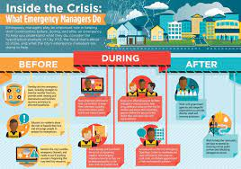
Emergency Preparedness
Drills and Exercises – required by NJOEM
  OEM recommends testing seven annexes each year
    Individual organization Exercise
    “Tabletop” Exercise
    “Functional” Exercise
    “Full-Scale” Exercise
Town-Wide Alert System
  Consider power outages
Financial Planning

Slide 92
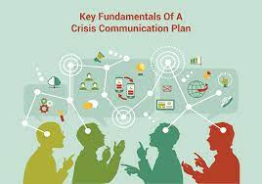
Crisis Communications

Slide 93

Crisis Communications
Developing a Crisis Communications Plan
  Must consider a wide range of possible events:
    Natural – Hurricane, Blizzard, Tornado, Super Storm
    Man-Made – Chemical Release, Infrastructure Failure
    Facilities – Explosions, Structural Collapse
    Criminal – Official Misconduct, Data Breach, Terrorism
    Legal or Regulatory – Major Lawsuit
    Human Resources – Labor Issues or Loss of Key Officials
    Reputational – Social Media Crisis, Misconduct
    Proximity Crisis – Not us, but close enough to make an impact

Slide 94
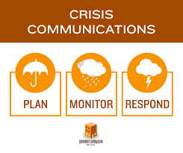
Crisis Communications Plan
Who will be in overall command for each scenario?
What is the potential impact on the public?
Who will be affected and how?
What emotions should we consider?
What are we going to ask the public to do?
What is the BIA, and if not available, when will it be available?
What CAN’T be said?
Is legal counsel needed?
Who is the spokesperson?
Who needs to be contacted in advance of any public announcements?
Does the issue have traction?

Slide 95
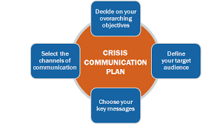
Crisis Communications Plan
No release until fully authorized
“No Comment” is never acceptable
Personnel matters are to remain confidential
May require constant and updated contact with stakeholders
Do not guess or speculate. Give only the BIA
Anticipate the needs of media representatives
Designate a liaison to stay in touch with families
The quality of the message should always be “high”
When the crisis is over, conduct a post-mortem evaluation
Keep good records

Slide 96

Crisis Communications Plan
CDC Planning for Crisis Communications:
  Be First – time sensitive
  Be Right- accuracy is important
  Be Credible- honesty
  Express Empathy – address feelings
  Promote Action- restores order
  Show Respect – promotes cooperation

Slide 97







Community Safety

Slide 98

Community Safety
NJSafetyInstitute.org
Created in 2013 to provide information to local officials about exposures in local communities impacting quality of life.
Overall rate of accidental fatalities in the US has INCREASED by over 40% since 2000 to 49 fatalities per year per 100,000 population.
Accidents cost the US over $1 trillion per year which equals 5.3% of the GNP
NJ has the 13th highest pedestrian accident rate in the US.

Slide 99

Focus on Issues that Cut Across all Localities
Youth Sports
  More than 750,000 Americans are injured during recreational sports with brain injuries causing more deaths than any other sports injury.
  In any given football season, 10% of all college players and 20% of high school players sustain brain injuries
  Rutgers SAFETY Clinic course includes training on sports concussions and the CDC has a free online training program (that can be accessed through the NJ Safety Institute’s site) that produces a certificate upon completion.
  The following are recommended Best Practices to reduce the risk of concussions:
    Match players according to size, weight, and training in drills
    Limit tackling and blocking in practice
    Emphasize “keeping the head out of football”
    Never face or head tackle
    Train consistently and properly

Slide 100
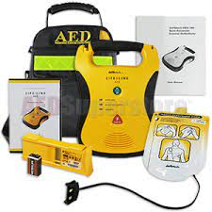

Janet’s Law
Janet's Law requires every district/school to have an AED available in an unlocked location on school property with an appropriate identifying sign. ... The AED must be within reasonable proximity of the school athletic field or gymnasium, as applicable. And a coach, trainer, staff member, EMT or First Responder trained in CPR and AED use must be present for all practices, events and games.
Janet's Law is named after Janet Zilinski, an 11 year old who died from sudden cardiac arrest (SCA) in August 2006 at cheerleading practice in Warren Township, New Jersey.

Slide 101

Playground Safety
Playground accidents account for more than 200,000 injuries in the US.
The Consumer Product Safety Commission (CPSC) developed the playground safety standards adopted by the State of NJ, which can be found on the NJ Safety Institute and NJ MEL websites.
The Safety Director’s office has nine Certified Playground Safety Inspectors (CPSI) that work with local municipalities and counties.
Each town and county should conduct an initial inventory and an annual audit of all of their playgrounds and play areas using the playground safety checklist on the NJMEL website.
A trained employee should be assigned to conduct weekly inspections as well, especially during months of high usage.

Slide 102

Bicycle Safety
Bicycle helmets are 85% to 88% effective in preventing brain injuries. Universal use of helmets could prevent one death per day and one brain injury every four minutes.
200 children under the age of 15 are killed each year in bicycle accidents.
NJ requires all children under 17 to wear helmets while bicycling, in-line skating and participating in other “wheeled activities.”

Slide 103

Senior Citizen Injuries
Slips and Falls – the leading cause of injuries and deaths among senior citizens and more than 1/3 of adults ages 65 and older fall each year.
Motor Vehicle accidents – Many seniors are unwilling to assess their driving capabilities
Pedestrian Accidents and Fatalities – Seniors account for 18% of all pedestrian fatalities annually.
Suicide – Becoming an increasing problem in the senior population, and high rates of alcohol involvement have been found among seniors who commit suicide
Fire – Older adults suffer twice as many deaths as the general population. Seniors aged 85 and older are four times as likely to die in a fire than other age groups.

Slide 104

What can be done to address Senior Citizen Injuries?
Community outreach through organized senior organizations, homeowners associations in senior communities, church groups, and social media to better educate seniors on safety enhancements in their homes.
Take the time to find out what social programs are available to seniors and determine if there are impediments (such as lack of transportation) preventing them from attending.
An analysis by the local government of intersections and sidewalk areas used by seniors for improvement and modification.
Discuss the frequency and severity of vehicular accidents caused by seniors with your Chief of Police and find out what remedial actions can be taken.
Work with the local fire department to enhance awareness for the use of smoke and CO2 detectors and search for grant programs to make the detectors available, free of charge, to seniors who cannot afford them.

Slide 105
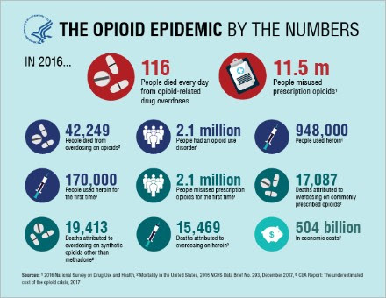
Opioid Epidemic

Slide 106

Opioid Epidemic
NJ is one of the States hit hardest by the epidemic.
NJ experienced 16 deaths per 100,000 people as compared with 13.3 deaths nationwide.
The NJ rate of deaths in increasing annually.
2013 “Overdose Prevention Act” – immunity from arrest when a person seeks medical help in good faith for himself or another person.
  Operation Helping Hand – Law Enforcement combines with community health agencies to engage individuals suffering from addiction to receive treatment and recovery services.
  Police Assisted Addiction and Recovery Initiative (PAARI) allows individuals to come to police departments to be immediately connected to recovery programs without fear of arrest.

Slide 107
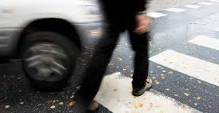
Pedestrian Safety – The Stats
About 70,000 pedestrians are injured and more than 4,000 are killed in motor vehicle related accidents in the US each year.
  Age is a factor
    Accident rate increases at age 5 and drops at 25. Rises again at age 75 to 84.
  Drugs and alcohol are factors
  Speed and Distracted Driving
    11% of all motorists are on their phone at any time. Cell phones are also a factor for pedestrians.
    Survival rates decrease when a vehicle is traveling faster than 30 MPH
    Statistics show that drivers were “looking away” for at least three seconds before striking a pedestrian

Slide 108
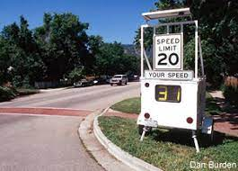
Pedestrian Safety – Solving the Problem
Focus on making the community more “pedestrian friendly.”
Identify accident “hot spots” with assistance from the police traffic safety officer.
Inspect the intersections
Utilize the services of a qualified and experienced Traffic Engineer to evaluate intersections and problem spots, including a review of:
  Speed limits
  Pedestrian Crosswalks if applicable
  Changing the sequencing of traffic signals at intersections
  Installation of traffic calming measures
  Use of pedestrian islands
Invest greater time in community education on the trouble spots and enlist citizen input to enhance awareness.
Ask the police to consider speed monitoring and, if necessary, enforcement in troubled areas.

Slide 109

Ethics for Public Officials and Employees

Slide 110



Ethics for Public Officials and Employees
Since those of you enrolled in the Leadership Academy are required to take our Ethics Course, this section will be a condensed summary.

Slide 111
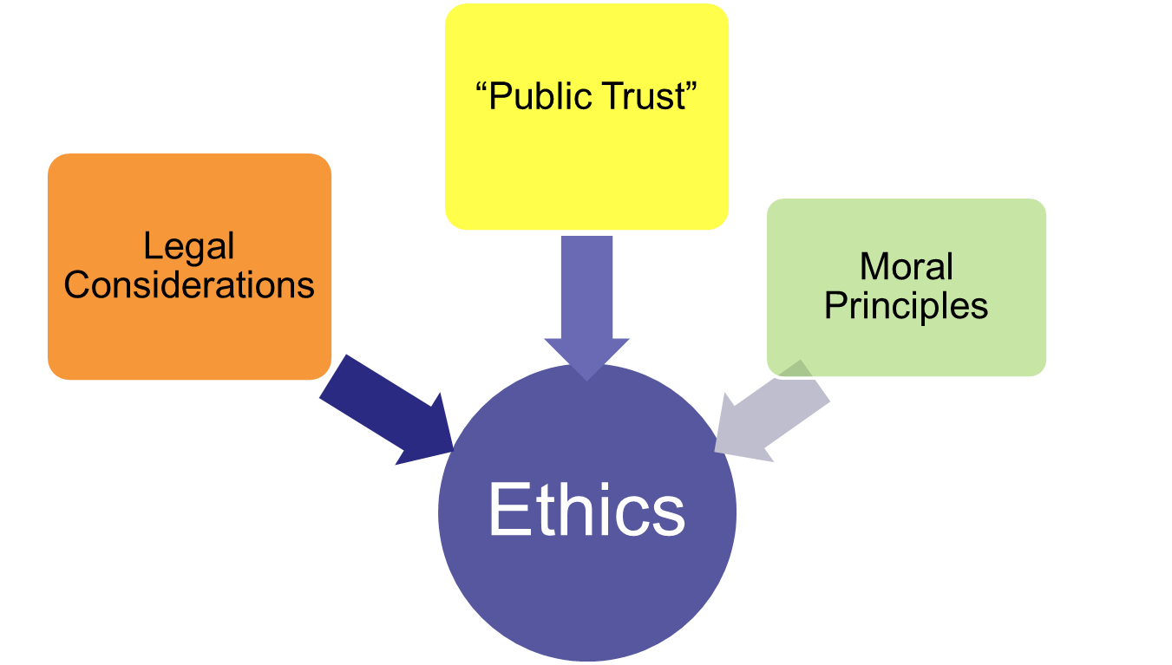
The Components of our Ethical Decision Making

Slide 112

NJ Local Government Ethics Act N.J.S.A. 40A:9-22.1, et. Seq.

Slide 113

NJ Local Government Ethics Act
Enacted in 1991 to ensure that local government officials and employees have ethical standards and financial disclosure requirements that are clear, consistent, uniformly applied and enforceable statewide.
The Ethics Law established:
  A structure for oversight and regulation of local government officials and employees, with options
  A code of ethics
  Financial disclosure requirements

Slide 114
NJ Local Government Ethics Act
The Recurring Themes in the NJLGE Act
  Public Trust
  Integrity
  Avoidance of Conflicts of Interest
  Faithful Performance of Public Duties
  NOTE: Monetary Penalties for violations are minimal. However, additional penalties may be imposed (i.e. suspension, revocation of licenses, referral to County Prosecutor)

Slide 115
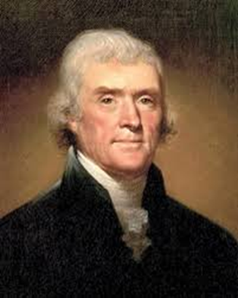
The Public Trust
“Public service is a public trust, requiring you to place the loyalty to the Constitution, the laws, and ethical principles above private gain. You shall not hold financial interests that conflict with the conscientious performance of duty.”
  Thomas Jefferson

Slide 116

NJ Local Government Ethics Act
Covers anyone who is elected, employed or appointed.
The “Code of Ethics” is the cornerstone of the law, setting forth the actions that are prohibited:
  Direct and Indirect conflicts of interest by either the employee, members of their immediate family or business organizations the employee or members of his immediate family have an interest in.
  Government officers and employees are prohibited from other employment that may conflict with their official positions.
  Cannot accept gifts , meals or other entertainment if there is any inference that someone is attempting to influence their decisions. (Does not apply to political contributions).
  Cannot use information learned during official duties that is not generally available to the public at large
  Cannot represent parties before boards or agencies in their town

Slide 117

NJ Local Government Ethics Act
Cautionary Advice:
  Do Not:
    Use governmental equipment or vehicles for personal business including volunteer activities or political campaigns
    Request that governmental employees work on your property, personal business or political campaigns.
    Use governmental information that is not commonly known for personal gain. A good test is to avoid using information that is not available through OPRA.
    Meet alone with developers or others seeking advantages from you. Keep a written record of all meetings including who attended and what was discussed.

Slide 118
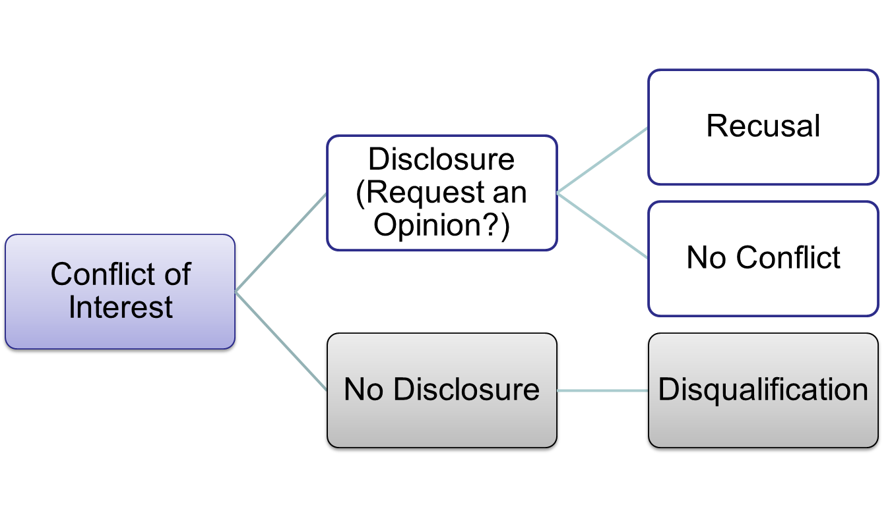
When a Conflict or a Perceived Conflict Arises

Slide 119

Enforcement of the NJ Local Government Ethics Act
Municipalities and Counties have a choice:
  Creation of “local” Ethics Board; OR
  Defer to the NJ Local Finance Board

Slide 120
LFB OR Local Ethics Board Powers
  To initiate, receive, hear, and review complaints and hold hearings
  To issue subpoenas
  To forward to the county prosecutor or the Attorney General or other governmental body any information concerning violations of the law.
  To render advisory opinions
  To enforce the provisions of the Code of Ethics
  To adopt rules and regulations necessary to implement the act.

Slide 121

Ethics Complaint Process
Complaint is filed and the Board has 30 days to act:
  Board determines the validity and jurisdiction of the complaint. If the Board determines the complaint is frivolous or outside of the Board’s jurisdiction, the complainant is notified.
  If the complaint is valid and within the Board’s jurisdiction, the officer who is being accused of the violation is notified and a hearing is held.
  The board must render a decision made by at least 2/3 of the members.

Slide 122
Penalties for Violations
A local government officer or employee found guilty of violating the NJLG Ethics Law or any other code of ethics shall be fined not less than $100 or more than $500.
However, the finding that a local government officer or employee is guilty of violating the law or any other code of ethics, may be sufficient cause for removal, suspension, demotion, or other disciplinary action.
These penalties are IN ADDITION to any other civil or criminal penalties provide by law.
“A local government official in NJ must be aware that unethical conduct may result not only in removal from office, public embarrassment, fines, and abrogation of actions in the official participated, but depending on the type and severity of the conduct, may result in criminal penalties, including imprisonment.”
      Thomas P. Scrivo, “NJ Local Government Deskbook, 2019 edition.

Slide 123
Financial Disclosure Statements (FDS)
Requires ANNUAL electronic filing of Financial Disclosure Statement by “local government officers” before April 30th of each year.
  Local government officers are defined in the law as:
    Elected to any office or a local government agency; or
    Serving on a local government agency, which has the authority to enact ordinances, approve development applications or grant zoning variances; or
    Who is a member of an independent municipal, county, or regional authority; or
    Who is a managerial executive employee of a local government agency.
All sources of income exceeding $2,000 received by the officer or member of his immediate family.
Each source of fees or honoraria exceeding $250 for any single personal appearance, speech, or writing received by the officer or member of his family.
Each source of gifts, reimbursements or prepaid expenses exceeding $400 from any single source (other than relatives) received by the officer or member of his immediate family.
The name and address of all business organizations in which the officer or member of his immediate family had an interest during the preceding year.
The address and brief description of all real property in the state in which the officer or member of his immediate family had an interest during the preceding year.

Slide 124
Please Keep In Mind
Financial Disclosure Statements are considered “public records,” and are available to be viewed and copied by the public through an Open Public Records Act (OPRA) request.
FDS forms are now routinely requested by political opponents, usually prior to or during a campaign.
SO….
  Make sure your information is factual, including any information required that pertains to your family.
  Make sure you did not neglect to mention anything.

Slide 125

NJ Open Public Meetings Act (OPMA)
Passed in 1975, requires that the public and the press be given advance notice and an opportunity to attend meetings, including executive sessions of public bodies, except where the public interest or individual rights would be jeopardized.
Transparency is the objective.
Applies to all phases of the deliberation, policy formulation and decision making process.
All meetings where a majority of the governing body is present. Also, official subcommittee meetings are included under OPRA.
“Partisan Caucuses” are excluded. (Maybe)
Electronic meetings require the same notice
Emergency Meetings should only be held for compelling circumstances.

Slide 126
NJ Open Public Meetings Act (OPMA)
A “meeting” is defined as any gathering of the quorum of any “voting body” held with the intent to discuss or act upon the business of the public body.
  Does not need to be “in-person” to qualify as a meeting
  Notice must be given in advance; Annual notice for regularly scheduled meetings;
    Emergency meetings still require notice as well.
  During COVID-19 (i.e., during a “declared emergency), public bodies are permitted to meet “remotely,” however, notice requirements must still be met.
  In NJ, time must be allotted for public comment
  Public body may adjourn to executive (i.e., closed) session for….

Slide 127

NJ Open Public Meetings Act (OPMA)
Nine (9) Exceptions:
  Any matter that federal law, state statute, or court rule expressly denotes as confidential.
  Any matter in which the release of information would impair a right to receive funds from the US government.
  Any material that constitutes an unwarranted invasion of privacy if disclosed, such as any records, data, reports, recommendations, or other personal material of educational training, social service, medical, health, custodial, welfare, housing, relocation, insurance, rehabilitation, legal defense, information related to an individual’s personal family circumstances, information pertaining to the admission or treatment of any individual.
  Collective bargaining agreements and negotiations of same.

Slide 128
OPMA – Closed Session Exemptions (Cont.)
  Purchase, lease or acquisition of real property with public funds, setting of banking rates or investment of public funds.
  Any tactics or techniques used to protect the safety and property of the public, provided that their disclosure could impair such protection, including investigations of violations or possible violations of the law.
  Pending or anticipated litigation or contract negotiation.
  Employment, appointment, termination of employment, terms and conditions of employment, the evaluation, promotion or disciplining of any prospective or current public officer employed or appointed by the public body.
  Any deliberations of the public body occurring after a public hearing that may result in the imposition of a specific civil penalty or the suspension or loss of license or permit upon the responding party as a result of an act or omission for which the responding party bears responsibility.
    Adoption of a Resolution by the governing body setting for the reason for the executive session is required.
    Minutes of the closed session must be kept and made available once the matter(s) are no longer confidential.

Slide 129
OPMA
Public Participation
  Required, time limits may be set, and rules of “decorum” may be established
Decorum
  “No person is permitted to make personal, impertinent, slanderous or profane attacks.” Warnings need to be issued before public comment.
Right to Record and Film
  First amendment rights. Subject to reasonable time, place and manner limitations, should be established by ordinance.
First Amendment Audits
  Social movement, to test compliance with First Amendment rights.
“Rice” Notices – From a case in 1977. Employees must receive advance notice whenever the governing body will discuss a matter negatively impacting the employee. Employee may elect for the discussion to be in public.

Slide 130
Maintaining Decorum During Public Meetings
Proper protocols need to be established annually at the Reorganization meeting
Enforcement of the protocols must be consistent.
Reasonable time limits may be set for citizen comment.
Meeting curfews may be set.
Avoid getting into a debate with citizens at a public meeting
Be careful of your body language when you are presiding at a public meeting.
If matters get out of hand, call for a short recess.

Slide 131
Court Cases – Open Public Meetings
Kindt v. Santa Monica (1995)
  An apartment owner was ejected from a Rent Control Board meeting on a number of occasions for trying to speak at various times throughout the meeting. He argued that limiting comment to the end of the meeting meant that he could not share his views when the resolutions were actually being decided. He often heckled the Board and other speakers.
  The Court ruled that “The Board regulations restricting public comment to 3 minutes per item at the end of the meeting are the kind of reasonable time, place, and manner restrictions that preserve a board’s legitimate interest in conducting efficient and orderly meetings.”

Slide 132
Court Cases – Open Public Meetings
Olasz v. Welsh (2008)
  After a Council Member was repeatedly ruled “out of order,” he was arrested and charged with a criminal disorderly person offense. The County Prosecutor threw out the complaint, and the Council Member sued the Council President for malicious prosecution. The Council Member admitted to disrupting the meeting but contended that his behavior was necessary to make his point.
  The U.S. Court of Appeals ruled that “The Council President’s actions to constrain the council member’s badgering, constant interruptions, and disregard for the rules of decorum constitute appropriate time, place and manner regulation.”

Slide 133
Open Public Meetings Decorum
Federal law recognizes that public bodies must maintain reasonable decorum, and speakers can be cut-off if they stray from the issue, are redundant or disruptive.
The municipal, county, or board attorney are your best assets. The role of the attorney at a public meeting is to help the Presiding Officer maintain decorum and not become a combatant.
Under both Federal law and New Jersey law, private citizens have some First Amendment rights to record public officials and employees performing their duties, but that right is not absolute and is subject to reasonable time, place, and manner restrictions.
Each local government needs a written procedure to address the right to record governmental facilities. Employees should be trained accordingly. There are model policies posted on the MEL Website.

Slide 134





OPRA

Slide 135
Open Public Records Act (OPRA) N.J.S.A. 47:1A-1 et seq.
Provides access to government records, specifically “public” records.
To qualify as a public record, it must be shown that the document was “made, maintained, kept or received” by a public employee or public entity in the scope of official business.
Definition of a “record” – any paper, written or printed book, document, drawing, map, plan, photograph, microfilm, data processed or image processed document, information stored or maintained electronically or by sound-recording or in a similar device, or any copy thereof…”
Once determined to be a public record, it must be “Readily Accessible”
Request form supplied by municipality (usually on their website)

Slide 136
Op
Open Public Records Act (OPRA) N.J.S.A. 47:1A-1 et seq.
OPRA requests that are “overly broad” may be rejected for that reason.
  Example: “Any and all records related to the construction of the new high school.”
  An appropriate OPRA request:
    “Any and all e-mails between Jane Doe and John Smith regarding the construction of the new high school from 1/1/2009 to 2/28/2009.”
OPRA provides that a Custodian of records must provide a copy of the record in the medium requested, if the public agency maintains the record in that medium.
If the record contains some “non-disclosable” information, that information may be redacted but the Custodian must explain the legal basis for redaction.

Slide 137

NJ Governments Records Council (GRC)
GRC vested with the legal authority to hear and decide disputes arising out of the NJ Open Public Records Act
May include order for losing party to pay legal fees
www.nj.gov/grc

Slide 138
Daniel’s Law (2020)
In November of 2020, Governor Phil Murphy signed into effect Daniel’s Law which amended P.L.1995, c.23, P.L.2001, c.404, P.L.2015, c.226, and supplemented Title 47 of the Revised Statutes. Daniel’s Law prohibits disclosure of home addresses or unpublished telephone numbers of certain law enforcement officers, judicial officers, and prosecutors. Criminal and civil action for disclosing such information is included in the regulations.
“The new law is named in honor of Daniel Anderl, the late son of U.S. District Court Judge Esther Salas. Daniel was killed in an act of senseless gun violence committed by an individual who had compiled a dossier of personal information about Judge Salas, including the judge’s home address.”
Presents challenges for the custodian of records for municipalities and counties.
An amendment to the statute was passed in 2021 to address those challenges, legislation (A-6171/S-4219), which would create an Office of Information Privacy to streamline the process.

Slide 139
Government Records Council Opinion 2005-127
A citizen requested “All documents, in electronic format, sent from or received by the Mayor to or from his personal e-mail account that relate in any manner to his position as a Fair Lawn Borough public official and/or the conduct of government by or for the Borough of Fair Lawn, from 1/1/2004 to 5/31/2005
The GRC ruled that the request was valid and ordered the Borough to comply. In a subsequent case, however, the GRC determined that OPRA requests for e-mail must contain: “the content and/or subject of the e-mail, (2) the specific date or range of dates during which the e-mail(s) was transmitted, and (3) the identity of the sender or recipient.”
NOTE: Officials who use their PERSONAL e-mail accounts on official business open themselves to numerous legal issues.

Slide 140
Court Cases – OPRA - Avid v. Oradell (2005)
The town rejected an OPRA request for the list of all homeowners who applied for a fire alarm or burglar permit in the last three years on the grounds that the documents fall under the emergency or security exemption.
The GRC UPHELD the town’s decision by applying the “balancing test.” In a situation like this, the GRC weights the public’s right for information against the potential severity of the security’s exposure.
In 2021 the GRC UPHELD the decision to deny release of dog and cat licenses. However, in another case the GRC UPHELD a decision to access the building plans for a home.

Slide 141
Court Cases – OPRA –Matthews v. Atlantic City (2009)
A frequent critic requested a “demotion list,” including base salaries before and after the demolition. He complained that the document that he ultimately received did not contain that information. The City argued that no document exactly complied with the request.
The GRC Ruled that a Custodian “was under no obligation to create a list compatible to the Complainant’s OPRA request because OPRA does not require a Custodian to produce new documents.”
Electronic records may be treated differently depending on the circumstances.
John Paff – Transparency NJ, Chairman of the NJ Libertarian Party’s Open Government Advocacy Project.
  https://transparencynj.com/author/john-paff/

Slide 142
Court Cases – OPRA –Burnett v. Gloucester County (2010)
Plaintiff requested documents related to “Any and all settlements, releases or similar documents entered into, approved or accepted from 1/1/2006 to present.” The county responded that many of these documents were in the files of the county’s insurance broker.
The Court ruled that agreements settling claims involving the county were government records and that the county had an obligation to secure the requested records from its insurance broker.
  “Were we to conclude otherwise, a governmental Agency seeking to protect its records from scrutiny could simply delegate their creation to third parties or relinquish possession to such parties, thereby thwarting the policy of transparency that underlies OPRA.”

Slide 143

OPRA – “Words to Live By”
Unless you are 100% comfortable with reading it on the front page of the Asbury Park Press, Star-Ledger, or on the internet, do not write it in an email to anyone or text it to anyone. There are no secrets in local government.
If you use your personal phone, tablet or laptop at any time for work purposes, the information on those devices may be accessible under OPRA.
Be very careful and seek advice from your attorney before you determine a document is not a “public record,” or before you start redacting a public record.
There are deadlines that MUST be met unless the requesting party grants an extension. Some records must be immediately available. The usual time frame is 7 days.
Fees may be charged at .05 cents per letter size paper and .07 cents for legal size. You can impose additional charges but only if you can prove the time spent.
GRC hears appeals and attorney’s fees may be charged if you lose.

Slide 144
Resources – Page 177
Medical Exams for Crossing Guards
Guidelines for Firefighters Physicals
Model Title 59 Resolution Approving Plan Design
Model Indemnity Ordinance
Model Tort Claim Notice
MEL Guidelines for Contracts and Use of Facilities
Special Events Checklist
Model Resolution or Ordinance Concerning Meeting Decorum
Model Policy for First Amendment Right to Record Meetings
Model JIF Documents

Slide 145
Questions?
This concludes Part 2 of the Power of Collaboration.
Thank you for your attention.
My Contact Information:
      Paul J. Shives, Safety Director
      Pshives@jamontgomery.com
      609-290-5686 (Cell Number)

