Slide 1

State of the Insurance
Market
Cyber & Technology Controls
2021 MEL NJCE MRHIF Summit

Slide 2
State of the Insurance Market

Slide 3
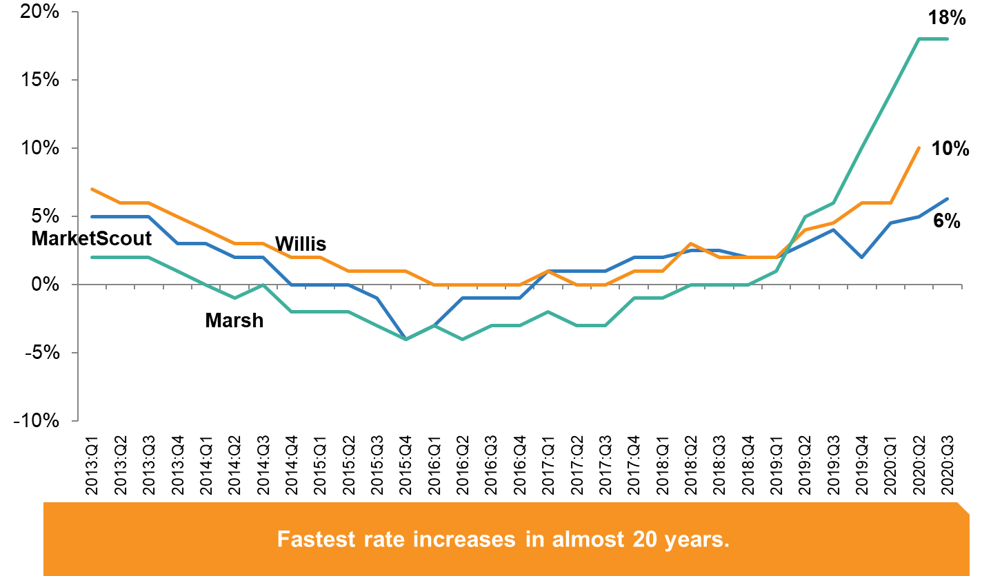
Rate Changes
22% - Marsh
iii 2020 Q4
Notes:
https://www.ciab.com/resources/q1-2020-p-c-market-survey/

Slide 4
Rate Changes
CIAB 2020 Q4
Notes:
https://www.ciab.com/resources/q1-2020-p-c-market-survey/

Slide 5
Rate Changes
Commercial Auto
Commercial Liability
CIAB 2020 Q4
Notes:
https://www.ciab.com/resources/q1-2020-p-c-market-survey/

Slide 6
Rate Changes
CIAB 2020 Q4
Notes:
https://www.ciab.com/resources/q1-2020-p-c-market-survey/

Slide 7
Rate Changes
20% - Marsh
CIAB 2020 Q4
Notes:
https://www.ciab.com/resources/q1-2020-p-c-market-survey/

Slide 8
Rate Changes
CIAB 2020 Q4
Notes:
https://www.ciab.com/resources/q1-2020-p-c-market-survey/

Slide 9
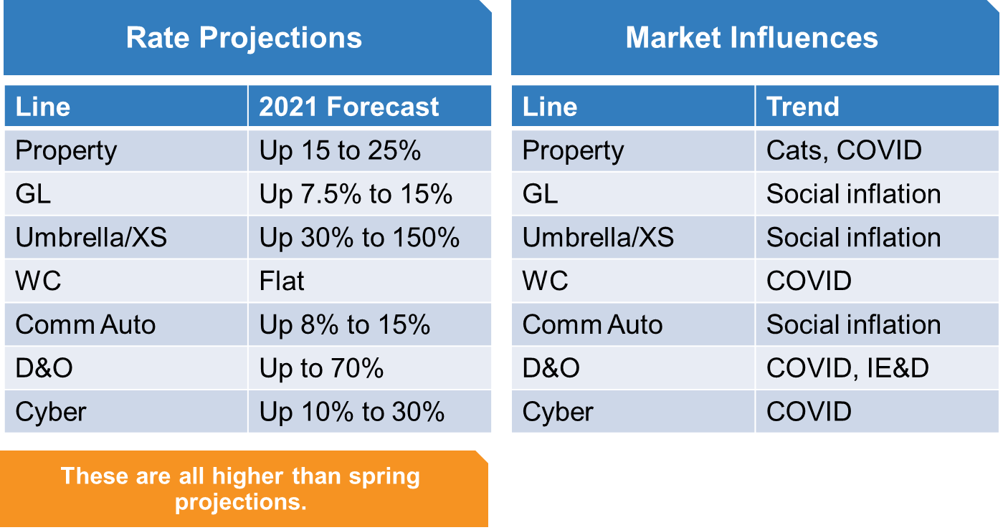
Rate Changes
iii 2020 Q4
Notes:
https://www.ciab.com/resources/q1-2020-p-c-market-survey/

Slide 10
Underwriting Capacity

Slide 11
State of the Insurance Marketplace
Why?

Slide 12
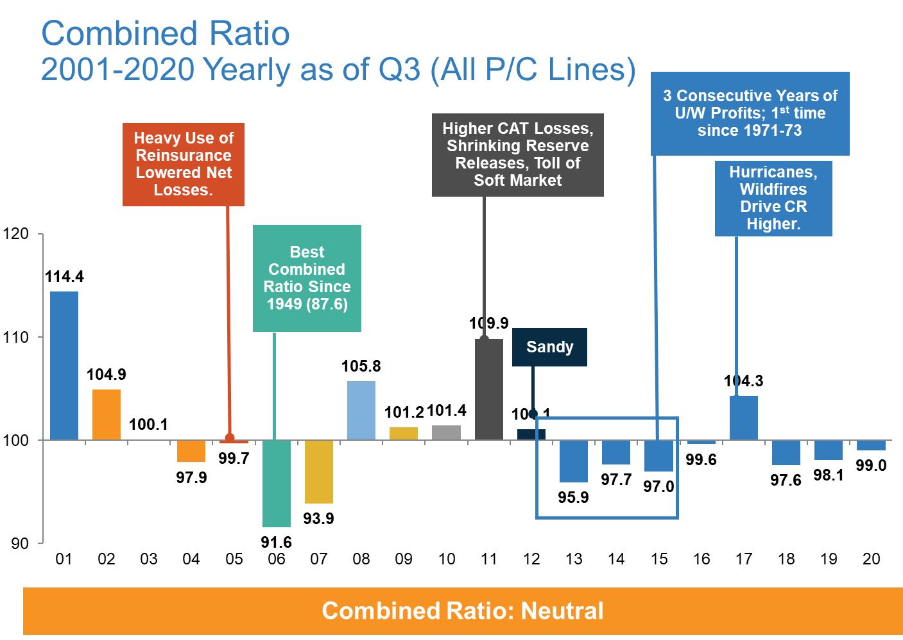
Underlying Trends
iii 2020 Q4
Notes:
https://www.ciab.com/resources/q1-2020-p-c-market-survey/

Slide 13
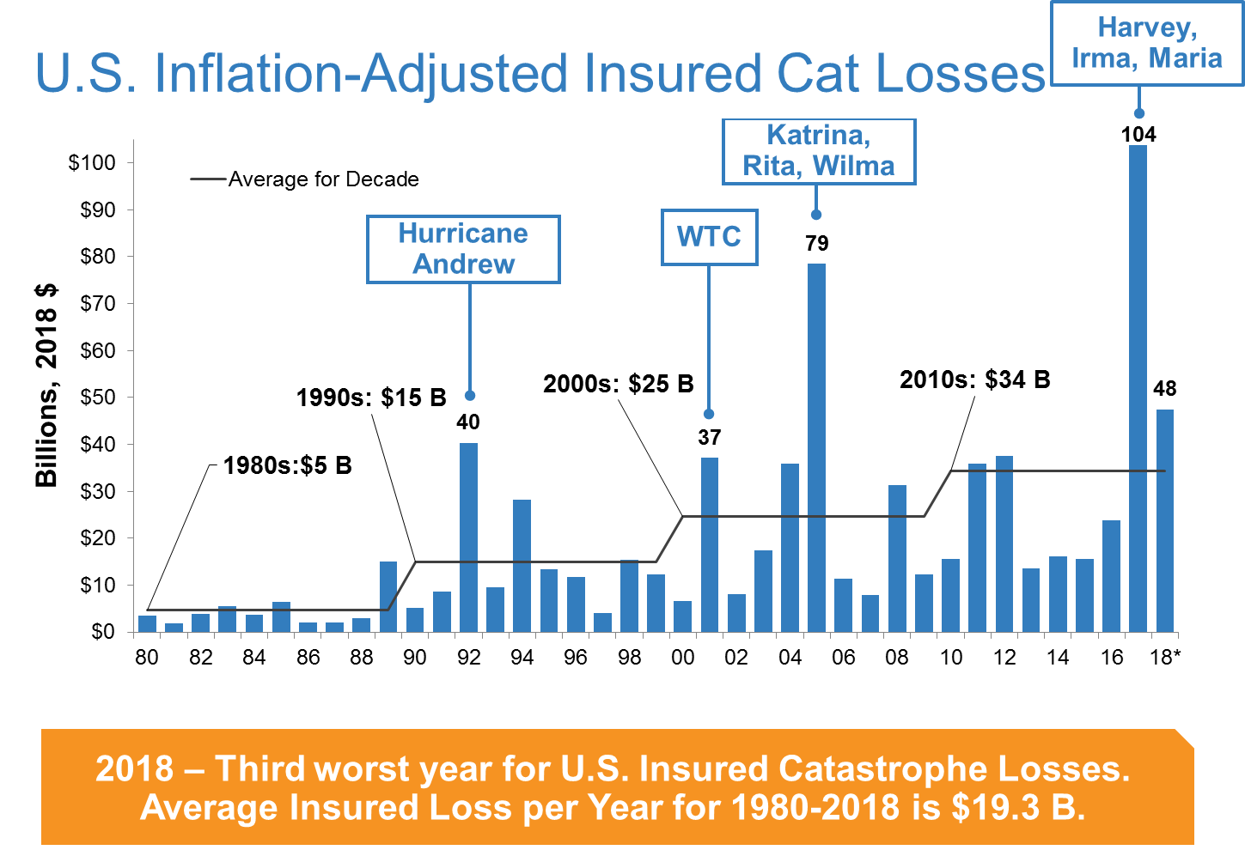
Underlying Trends
iii.org 2019 Q2
Notes:
NOAA predicts 25 named storms for 2020 (highest in history).

Slide 14
Underlying Trends
Social Inflation
A Good Definition
“a fancy term to describe rising litigation costs and their impact on insurers’ claim payouts, loss ratios, and, ultimately, how much policyholders pay for coverage.”
Actuarial Interpretation
“Excessive inflation in claims.”
  Occurs when development defies key assumption: Loss Development is RV about stable mean

Slide 15
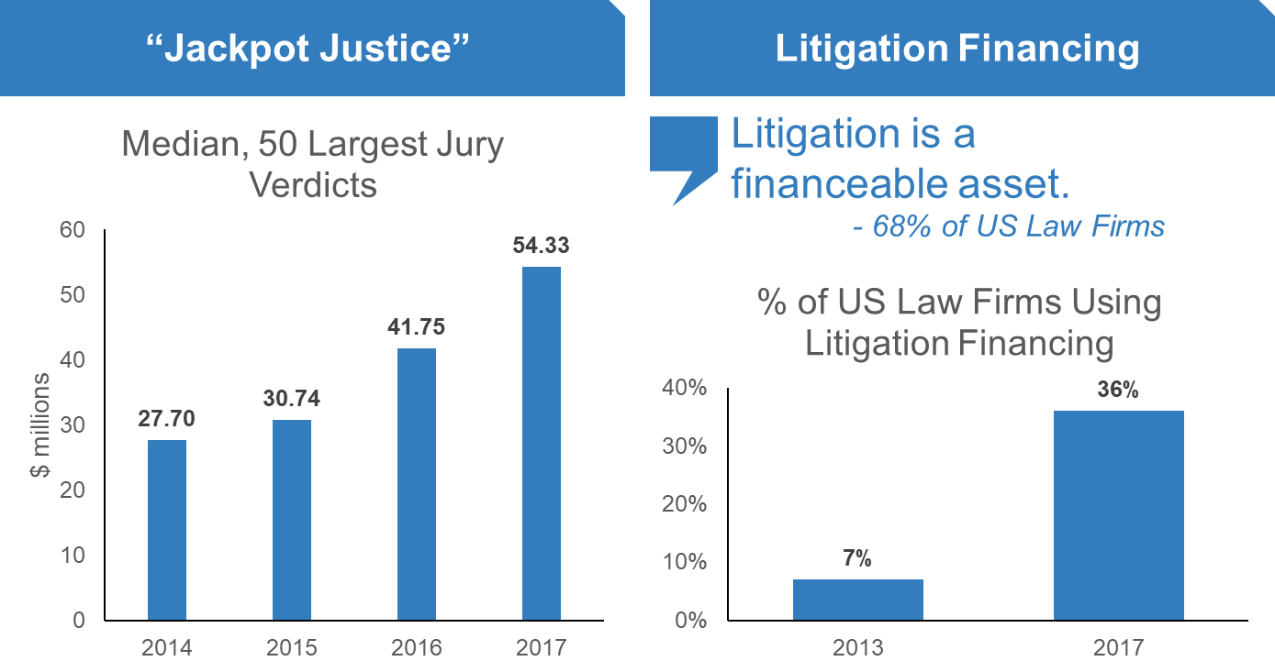
Underlying Trends
Social Inflation
iii 2020 Q4

Slide 16
Underlying Trends
Social Inflation

Slide 17
Underlying Trends
Social Inflation

Slide 18
Underlying Trends
Social Inflation – MEL JIF
40% Increase in LDF

Slide 19
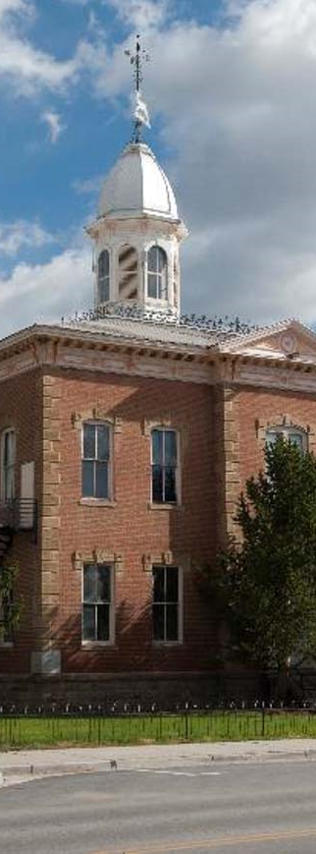
Public Entity Focus
PRICING
CAPACITY
Property, Auto and Excess Liability pricing has experienced the largest overall increase in recent months, increases unseen in three decades. For Excess Liability, many markets are imposing renewal increases between 30% and 500%. Carriers are focusing on underwriting discipline, including sexual abuse, social inflation and increased litigation costs. Executive risk lines such as Public Officials / Employment Practices Liability and Cyber are also experiencing pressure due to heightened loss experience nationwide.
The final months of 2019 witnessed certain insurers leave the Casualty market, including some reinsurers getting out of the United States altogether. Almost all insurers remaining in the space refuse to offer more than $5m in limits; this is primarily due to restrictions to reinsurance treaties and adverse loss experience. Capacity has contracted in most other lines. The majority of market share is still placed with a few Carriers that maintain a keen focus on the Public Entity Industry.
MARKET CONDITIONS
COVERAGE
From a coverage standpoint, the market is relatively stable, but some hardening is occurring. Existing programs are experiencing minimal contraction of coverage or terms. Exception to this is found in the property arena, where certain insurers may seek to contract limits in CAT exposed locations (i.e. Flood, Named Storm). Carriers continue to introduce new policy forms and endorsements in an effort to stay current with the marketplace, and gain a competitive advantage against competitors.
CHALLENGES
Sexual Abuse / Molestation legislation, Cancer Presumption legislation, Medical Marijuana, Cyber incidents and the effects of the COVID-19 pandemic continue to pose challenges for public entities across the state of New Jersey.
DEDUCTIBLES
Many insureds are maintaining their existing program structures, however there has been push for increases on clients with adverse loss development on Property, Excess Liability, Workers’ Compensation and Cyber. Overall, retentions and deductibles on other lines of coverage remain per expiring.

Slide 20
Emerging Risks
Social Inflation
Pandemic Risk
Sexual Abuse and Molestation Claims
Statutory Presumption Acts
Post Covid-19
Aging Infrastructure
Non CAT Property Loss
Climate & Weather
  Storm Surge Risk;
  Shortening and Intensifying Winters
  Increased Precipitation and Resulting Inland Flooding
  Intensifying Droughts
Internet of Things (IoT)
  Telematics and Connected Vehicles
  Connected Buildings/Cities
  Cybersecurity
    Cyber-attacks are now seen as one of the most serious economic and national security challenges now facing governments around the world.
Autonomous Vehicles
Nanotechnology
Marijuana Legalization & Workers Compensation
Notes:
https://www.iii.org/insuranceindustryblog/2020-insurance-fact-book-includes-new-section-on-emerging-risks/
https://www.mmc.com/content/dam/mmc-web/Files/AheadoftheCurve-UnderstandingEmergingRisks.pdf

Slide 21
State of the Insurance Marketplace
How Do We Combat It?

Slide 22
Renewal Strategy for Hard Market
Underwriting Information
Program Structure Alternatives
Widespread Marketing
Value of Carrier Loyalty and Relationships
Identify and Address Critical Risk Factors
Strengthen Safety Programs

Slide 23
Cyber & Technology Controls

Slide 24

What is
Cyber
really?

Slide 25
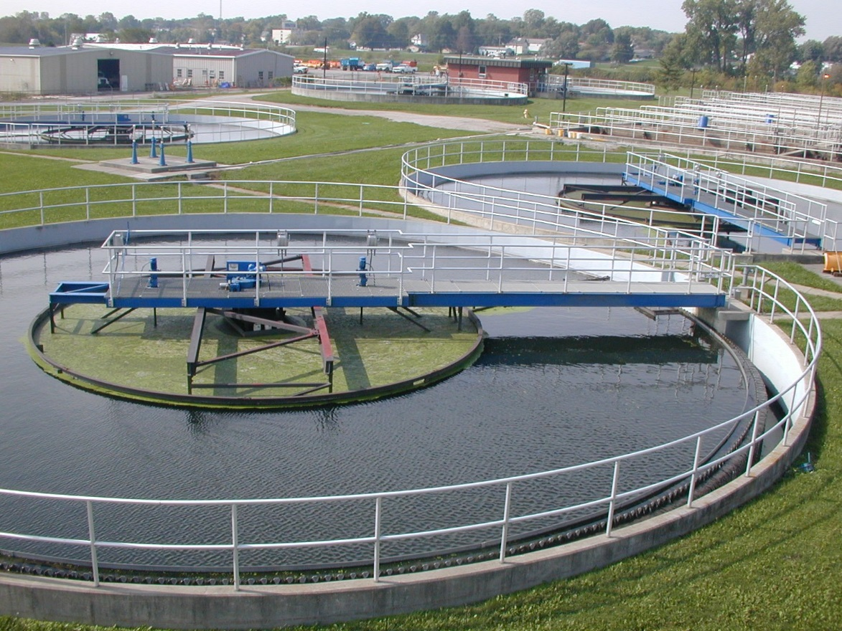
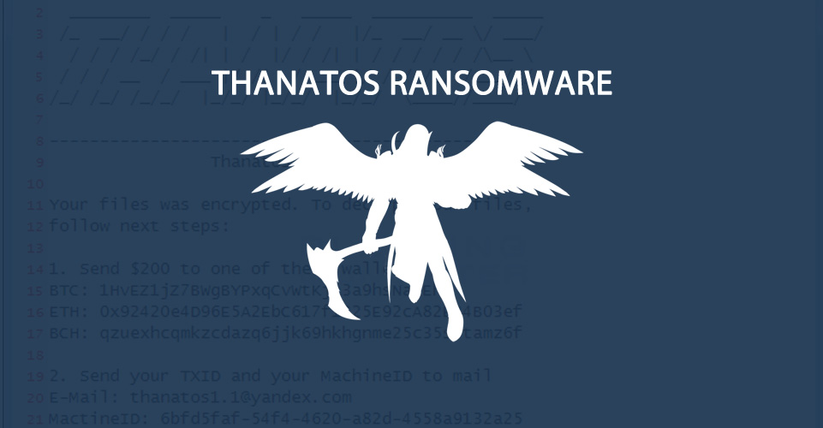
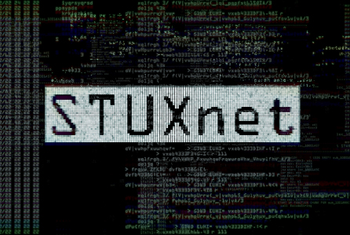

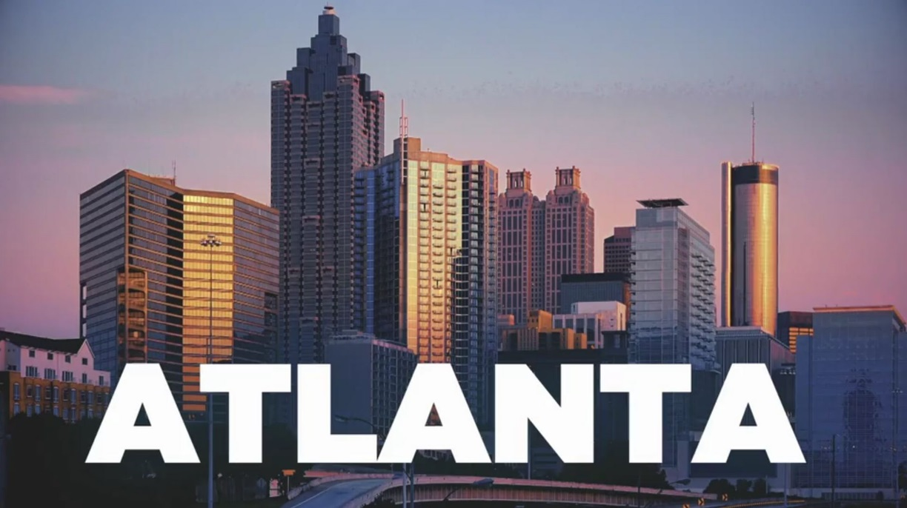

Slide 26
Cyber & Technology Controls
What Are The Trends?

Slide 27
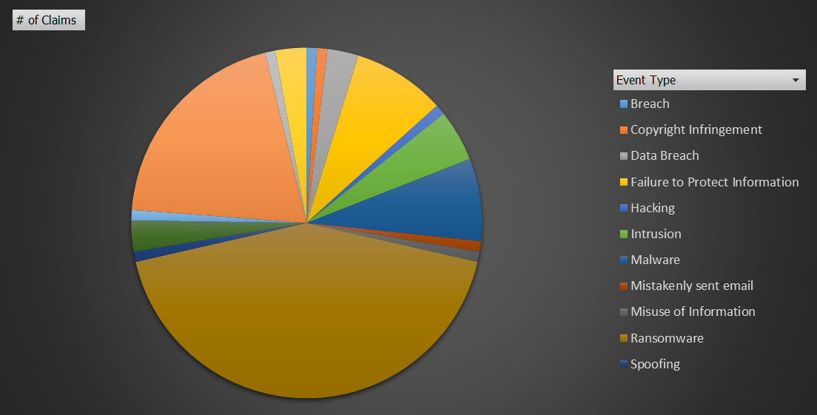
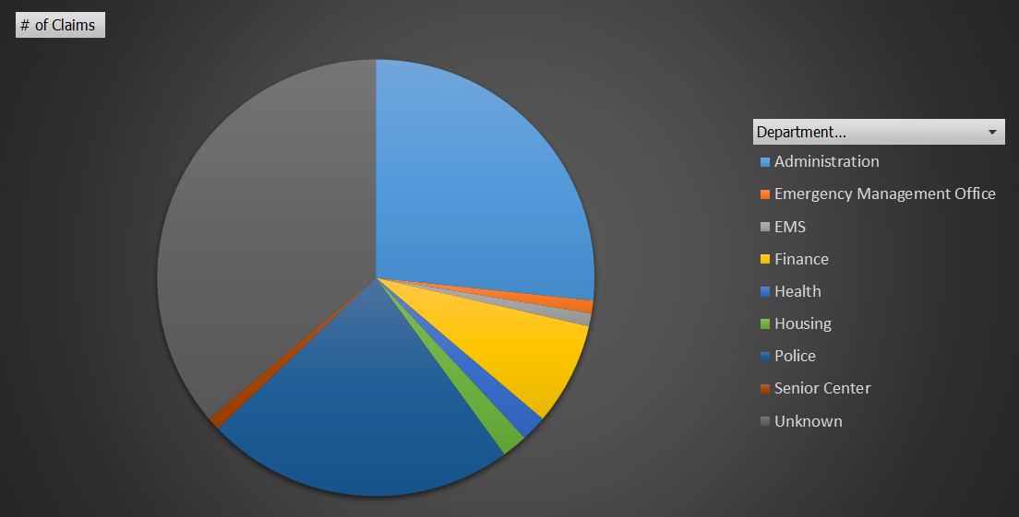
Claims Statistics
19% of breaches due to compromised credentials and 16% due to third-party vulnerabilities
2020 Ponemon Institue
By Department
By Event Type
48% of data breaches were caused by human error or system glitch (57% for Public Sector)
2020 Ponemon Institute

Slide 28
Root Cause Frequency and Severity
2020 Ponemon Institute

Slide 29
Time to Identify and Contain a Breach
2020 Ponemon Institute

Slide 30
Targeted Industries

Slide 31
Worldwide Cyber Experience

Slide 32
Worldwide Cyber Experience

Slide 33
Cyber & Technology Controls
How Do We Combat It?

Slide 35
Cyber Controls

Slide 36
Cyber Standards
Minimum
Minimum Backup Practices
  Weekly Backups Off-Network, Check Backups
Patch Management
  Be Aware, Patch ASAP, Non-Supported Apps
Defensive Software
  Antivirus, Firewall, Anti-SPAM, Close Unused Ports, Microsoft “Protected Mode”, EPP
Cybersecurity Training
  Malware Identification, Passwords, Security Incidents, Social Engineering
Policy & Procedures
  Incident Response Plan, Technology Practices Policy
Password Strength
  NIST standards (2020)
Email Warning Label
  Warning label for external emails
Next Step
Vendor Security Audits
Physical Network Protection
Access Privilege Controls
  Only Access What is Needed, Review
System/Event Logging
  Track all and check the logs
Protect Information
  Encrypt Files with PII/PHI
Remote Access
  Virtual Private Networks (VPN) and Multi-Factor Authentication (MFA)

Slide 37

Additional Practices
Additional Practices
Network and Back-Up Segmentation
Inventory Devices and All Digital Assets
Inventory Authorized & Unauthorized Software, and Whitelist Approved Software
Internet Content Filtering
Additional Cyber Hygiene Training
CIS Critical Security Controls and NIST Cybersecurity Framework
Network Access Controls (NAC) and Cloud Access Security Broker (CASB)

Slide 38
Thank You

Slide 39
THANK YOU
Questions? Comments?
Edward J. Cooney, MBA
VP, Account Executive
Underwriting Manager
P: 973-659-6424
ecooney@connerstrong.com

Slide 40
Conner Strong & Buckelew
Insurance, Risk Management
& Employee Benefits
Camden, New Jersey
1-877-861-3220
connerstrong.com
Edward J. Cooney, MBA
VP, Account Executive
Underwriting Manager
Commercial Lines
973-659-6424
ecooney@connerstrong.com
Jonathon Tavares
Account Manager
Commercial Lines
856-614-4493
jtavares@connerstrong.com
Crystal Chuck
Account Analyst
Commercial Lines
856-479-2115
cchuck@connerstrong.com
Rachel Perry
Technical Assistant
Commercial Lines
856-479-2128
rperry@connerstrong.com
Timothy J. Gosnear
SVP, Managing Director
Public Entity Practice Leader
Commercial Lines
856-479-2144
tgosnear@connerstrong.com
Terrence J. Tracy
EVP, Managing Director
Commercial Lines
856-479-2241
ttracy@connerstrong.com
Heather A. Steinmiller
General Counsel & Claims
Managing Director
856-479-2237
hsteinmiller@connerstrong.com

Slide 41





Stay Connected
Follow us on social media and visit our client portal to stay up to date on company news and industry trends.
Conner Strong & Buckelew
@connerstrongbuckelew
Conner Strong & Buckelew
@connerstrong
www.mypocketpandc.com

