Slide 1
2018 Land Use Liability
Dated April 23, 2018

Slide 2
Land Use Liability
This seminar is a part of an program to acquaint local officials with Risk Management principles. It is designed to provide a general understanding of legal principles pertaining to governmental operations. Seek the advice of your attorney to evaluate any particular case or circumstance.

Slide 3
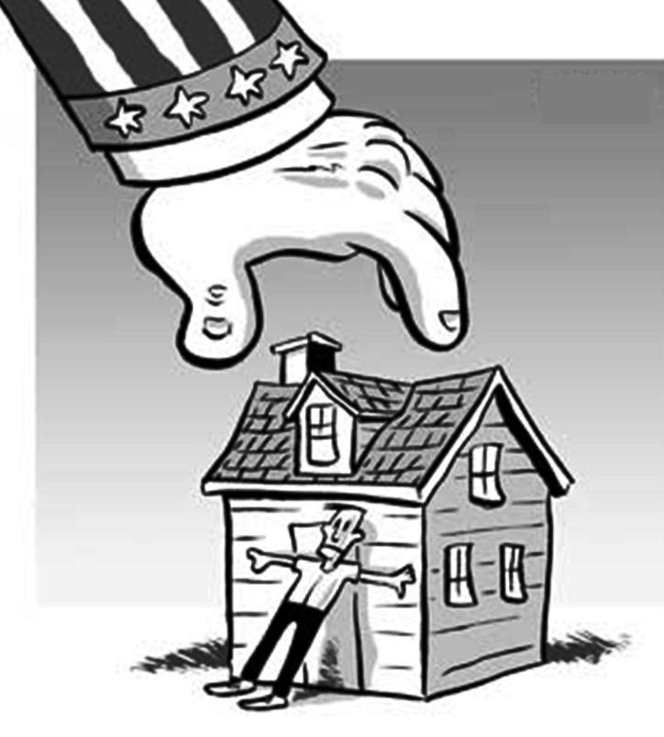
Land Use Liability
Delays in winning approvals are a normal part of the process and usually do not give rise to liability suits.

Slide 4
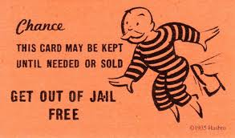
Land Use Liability
Land use Boards and individual members have the same protections from lawsuits as judges.
These immunities do not apply when a land use board violates civil rights.

Slide 5
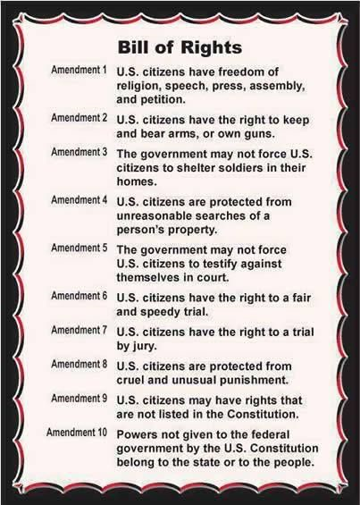
Land Use Liability
The starting point for land use law is the fifth amendment of the US Constitution which provides that private property shall not be taken for public use without just compensation.

Slide 6
Land Use Liability
In 1922, the Supreme Court extended this principle to so called inverse condemnation. This is where governmental regulation including zoning laws significantly diminishes the value of a private property.

Slide 7
Land Use Liability
No person has the right to use property in a fashion that threatens public safety or is so obnoxious that it materially impairs the rights of adjacent property owners. On the other hand, government does not have the right to adopt regulations that effectively prohibit any reasonable use of private property.

Slide 8
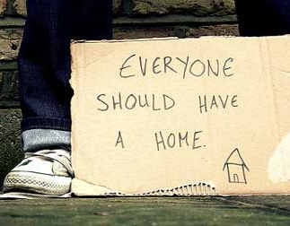
Land Use Liability

Slide 9
Land Use Liability
Fee Shifting

Slide 10
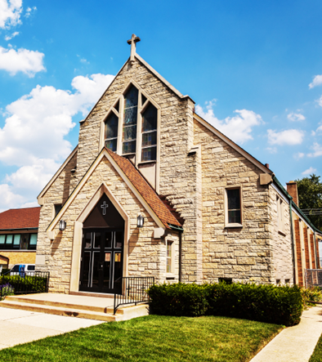
Land Use Liability
RLUIPA provides that no government shall impose land use regulation that creates a substantial burden on religious exercise unless in furtherance of a compelling governmental interest that is the least restrictive way of accomplishing that objective.

Slide 11
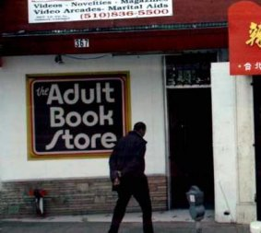
Land Use Liability
Schad v. Mount Ephraim (1981)

Slide 12
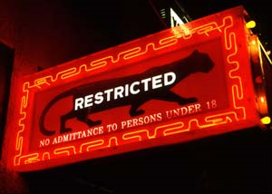
Land Use Liability
Renton v Playtime Theaters (1986)

Slide 13
Land Use Liability
Legal Recourse

Slide 14
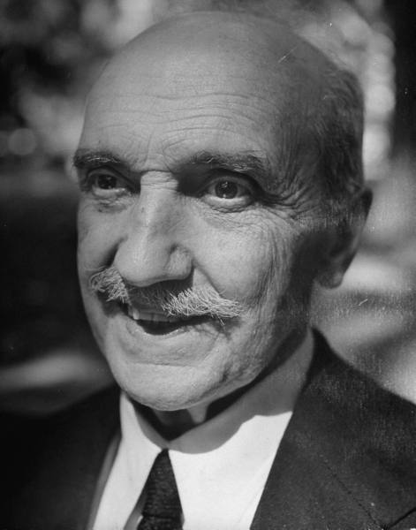
Land Use Liability
“Those who cannot remember history are condemned to repeat it.”
George Santayana
Life of Reason 1905
George Santayana (1863 – 1952)

Slide 15
Case Study One
While considering a change in the zoning law, the governing body expressed concern about the impact that a development would have on the town and the developer voluntarily offered to contribute $200,000 to offset some of these costs, although there was no legal requirement for the developer to make this contribution.

Slide 16
Case Study One
Is it legal for the governing body to accept the strictly voluntary contribution from the developer? YES or NO

Slide 17
Case Study One
NO: In Nunziato v Edgewater, the court ruled that absence a legal requirement, voluntary contributions of this nature are analogous to “pay to play” where favorable land use decisions go to the highest bidder.

Slide 18
Case Study Two
Members of a land use board visited the site of an application and engaged in a discussion with both the applicant and objectors. While most of the discussion was limited to specifics of the application, one of the members went beyond this and engaged in a heated dialogue with one of the parties. This member was recused from further deliberations.

Slide 19
Case Study Two
Is it legal for the other members of the board who were at this site meeting to continue in the proceeding? YES or NO

Slide 20
Case Study Two
YES: In Smith v Fair Haven the Court agreed that the recusal of the one member who engaged in the heated discussion was an adequate cure in this case. In its opinion, the court reiterated that discussion at site meetings must not go beyond the arguments and allegations advanced during the course of the board’s meetings. Further, the court emphasized that the knowledge gained from the visit should be placed on the record.

Slide 21
Case Study Three
An experienced developer received a Superior Court order instructing the town to approve a project after considerable delay. The planning board then willfully ignored the court ruling and rejected the application anyway. The developer sued both the town and members of the planning board personally. The Town settled out of court and a jury found three members personally liable, awarding damages of $5000 against each.

Slide 22
Case Study Three
Will discretionary immunity protect members of a planning board personally from punitive damages even if they willfully ignore an order of the Superior Court to approve an application? YES or NO

Slide 23
Case Study Three
YES: The immunity extended to individual members of land use boards even this case.
In Anastasio v W. Orange, the court wrote that:
“We think that the public interest requires that persons serving on planning boards…..act with independence and without fear that developers…..[will] bring them into court.

Slide 24
Case Study Four
A religious institution applied for variances to build a school in a residential zone. A Board member lived in a nearby development and coached her neighbors on what questions they should ask at the hearing. She did not recuse from the deliberations.

Slide 25
Case Study Four
Was the board member who helped residents draft their objections entitled to personal immunity? YES or NO?

Slide 26
Case Study Four
NO - In Muslim Community Association of Ann Arbor v Pittsfield Township, a US District Court ruled that:
“Absolute Immunity does not extend to …... actions of officials taken either in bad faith, because of corruption, or primarily in furtherance of personal instead of public interests.”

Slide 27
Case Study Four
Other Examples of Personal Liability:
During a close reelection campaign, the Mayor asked all members of the Planning Board from his party to vote against a controversial application. It is illegal to influence decisions for political or personal gain.

Slide 28
Case Study Four
Other Examples of Personal Liability:
A developer submitted a conforming application to build a commercial building that included a day care center. The Mayor forced the developer to scale back the application, but still voted against it. Subsequently, it came to light that the Mayor had an interest in another day care center nearby.

Slide 29
Case Study Five
During the hearing on a case involving the application to build a senior citizen home the Mayor created a storm when he said that this might be a good place for his mother to live.

Slide 30
Case Study Five
Did the Mayor’s comment create a conflict of interest that required him to recuse?
YES or NO

Slide 31
Case Study Five
NO. In Grabowsky v Montclair the court ruled that the Mayor did not have a conflict merely because his mother might move into the proposed senior center.

Slide 32
Case Study Six
A town purchased land for a parking lot. The Mayor then entered into an agreement to lease some of the spaces for his business. Subsequently, the town advertised bids to pave the parking lot and awarded the bid.

Slide 33
Case Study Six
Before voting on the contract award, the Mayor was advised by the municipal attorney that his vote on the award was not a conflict of interest even though his business would be using many of the spaces. A complaint was made to the Local Finance Board, which fined the Mayor $200 after deciding that the Mayor’s actions were clearly over the line. The Mayor then appealed.

Slide 34
Case Study Six
Did the Mayor qualify for the “acting under the advice of counsel” defense? YES or NO

Slide 35
Case Study Six
Yes. In Re Zisa, the Appellate court ruled that absent any indication of collusion, the fact that the Mayor requested and received the advice of the municipal attorney qualified the Mayor for the safe harbor defense.

Slide 36
Case Study Six
To be eligible for the safe harbor defense:
•The advice must be received prior to your action;
•The individual who offered the advice possessed authority or responsibility with regard to ethical issues. Simply relying on your personal attorney or a friend is not sufficient;
•The individual seeking advice made full disclosure of all pertinent facts and circumstances; and,
•The individual complied with the advice, including all the restrictions.

Slide 37
Case Study Seven
The owner of an otherwise conforming lot in a single family zone was prevented from starting construction by the DEP because of flood plain regulations. The DEP ruled that the property can only be used for open space, parkland or a parking lot. The owner sued arguing that this was inverse condemnation.

Slide 38
Case Study Seven
Did the court rule that the DEP’s actions constituted a taking through inverse condemnation? – YES or NO?

Slide 39
Case Study Seven
YES - In Mansoldo v State of New Jersey (2006) the New Jersey Supreme Court ruled that the in deciding inverse condemnation cases, courts must ask if the regulation effectively eliminates all economically productive use of the land. After answering this question, the courts must go further and determine if the regulation unduly interferes with legitimate investment-backed expectations of the property owner depending on various factors.

Slide 40
Inverse Condemnation?

Slide 41
Case Study Eight
A Muslim congregation proposed to build a conforming mosque and educational center on a site of a former hotel. Within two months, the Council adopted a revised zoning code that requires a church to seek a conditional use variance if located in a residential zone. In one of the hearings, no less than 500 citizens attended and things became quite ugly. The town argued that the area in question had winding roads and there were properties in other parts of town where the mosque could locate, although these properties were substantially more expensive.

Slide 42
Case Study Eight
Did the court accept the town’s position that it was not in violation of RLUIPA because the mosque could locate on other properties?
YES or NO?

Slide 43
Case Study Eight
NO - In Al Falah Center v Bridgewater, the Federal court was swayed by how quickly the council moved to change the zone. As a result of the decision, the town paid $2.5 million to purchase another property for the mosque and the township’s insurer paid the mosque’s legal bills that amounted to $5 million.

Slide 44
Case Study Nine
A zoning board conducted a hearing on a proposal to develop a mobile home park. Towards the end of the hearing, a resident spoke about a political controversy that was not relevant to the zoning issues before the board. He was asked to stop and when he refused, a scuffle broke out between the resident and the Board Chairperson.

Slide 45
Case Study Nine
At a hearing, can a land use board limit testimony to issues that are relevant to the decision before the board? YES or NO?

Slide 46
Case Study Nine
YES - The most frequently cited case in this situation is the 1990 decision in White v City of Norwalk where a Federal Court held that:
“In dealing with agenda items, the Council does not violate the first amendment when it restricts speakers to the subject at hand. While speakers cannot be stopped from speaking because the moderator disagrees with the viewpoint he is expressing, it certainly may stop him if his speech becomes irrelevant or repetitious.”

Slide 47
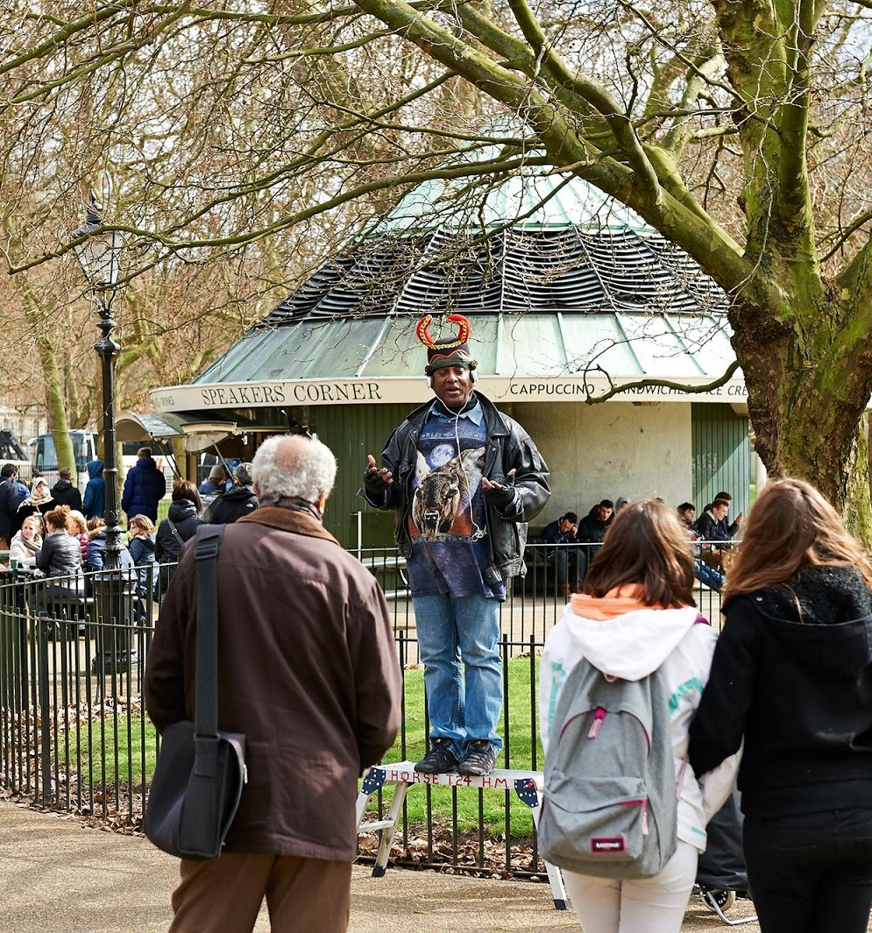
Case Study Nine

Slide 48
Case Study Nine
At the beginning of each meeting, in addition to the Open Meetings Act, there should be a statement to the effect that:
“This meeting is a judicial proceeding. Any questions or comments must be limited to issues that are relevant to what the board may legally consider in reaching a decision and decorum appropriate to a judicial hearing must be maintained at all time.”

Slide 49
Case Study Ten
A group of Orthodox Jewish residents attempted to create an enclosed “Eruv” zone so that they could push or carry objects outside their homes on the Sabbath. An Eruv can be established by running plastic string between utility poles. Where this has been done, the string is high and out of sight. The utility company agreed but after bitter controversy, the town decided to stop the plan by enforcing its 1954 ordinance that prohibits placing signs and the like on utility poles, fences, and other public places.

Slide 50
Case Study Ten
Did the town violate the resident’s civil rights by enforcing its sign ordinance to prevent the Eruv? YES or NO?

Slide 51
Case Study Ten
YES - The court based its decision on the fact the town’s action constituted selective enforcement because over the years officials ignored numerous other violations such as signs for yard sales, lost animals, house numbers, directional signs to churches, and the like. While all law enforcement is inherently selective, it is illegal to make that selection based on criteria that amounts to illegal discrimination.

Slide 52
Indemnification & Defense
New Jersey law allows towns to defend and indemnify their officials and employees for claims that arise from their performance of their official functions.

Slide 53
Indemnification & Defense
There is no legal requirement that the Council exercise this authority under Title 59 provided that the Council cannot be arbitrary and capricious in its decision.

Slide 54
Indemnification & Defense
Much of the uncertainty can be avoided if the town adopts an indemnification ordinance. Most towns have these ordinances and each of you should review the provisions.

Slide 55
Insurance
While every policy is different, universally these policies do not cover punitive damages, fines or penalties, fraudulent, dishonest, malicious, criminal or knowingly wrongful acts or omissions, and willful violations of statute, ordinance, rule, agreement, or judicial or regulatory order.

Slide 56
Insurance
These policies do not cover condemnation and inverse condemnation.
These policies will not pay for a defense in criminal court, even if the public official is subsequently acquitted.

Slide 57
When board members are sued personally for their alleged actions as part of a land use board and not indemnified, the MEL special policy will provide up to $50,000 (annual aggregate) in defense coverage for the following risks: 1) Criminal Acts; 2) Willful Violations; 3) Self-Dealing/Illegal Profit; and 4) Condemnation, by whatever name used.
Special Policy for Members of Land Use Boards

Slide 58
Precautions
Create an environment where your staff and attorney are encouraged to tell you what you should hear and not necessarily what you or the public wants to hear.
Do not meet meeting with applicants or opponents to an application alone.
Avoid saying anything that can be construed as bias, both at meetings and elsewhere.

Slide 59
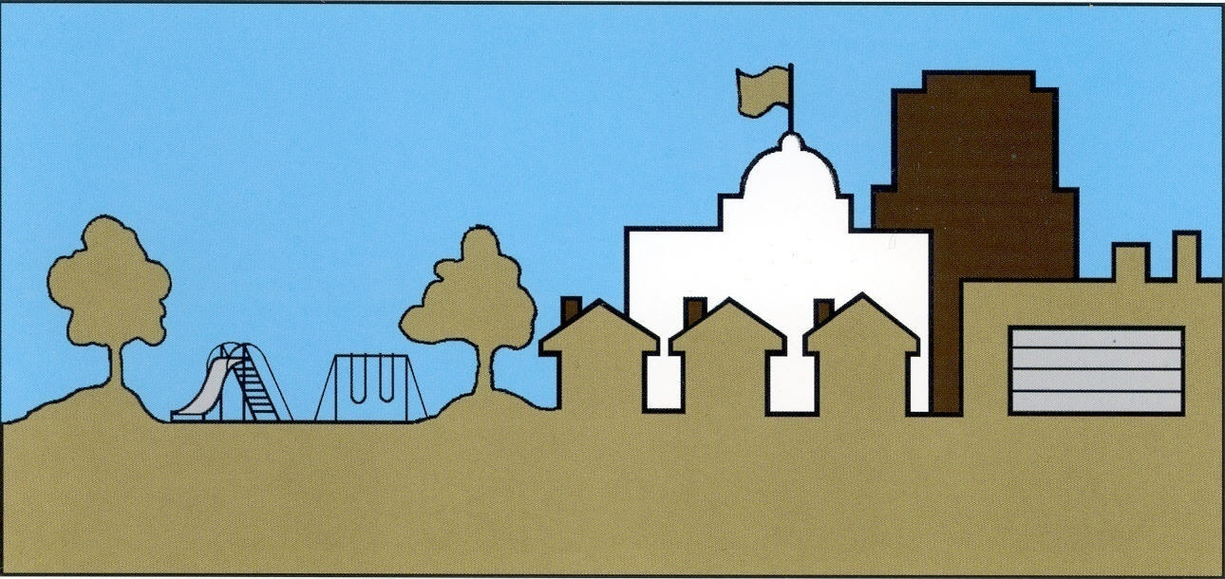
NJMEL.ORG

